Slide 1

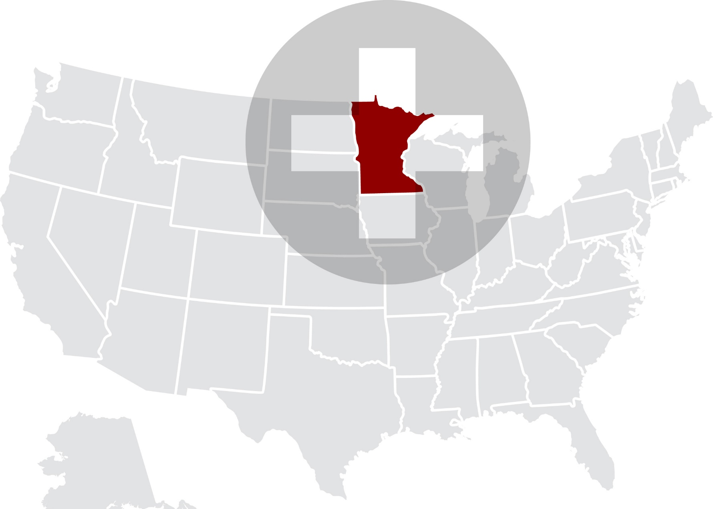
THE COST OF MENTAL ILLNESS:
MINNESOTA FACTS AND FIGURES
Hanke Heun-Johnson PhD, Michael Menchine MD, Seth Seabury PhD
MACMHP + BHECON Day on the Hill
05/03/2018

Slide 2



ACKNOWLEDGMENTS
Funding for this project was provided through an unrestricted grant from Alkermes.
This work was done as part of the Keck-Schaeffer Initiative for Population Health Policy.
We also acknowledge comments and contributions to this work from the
National Council for Behavioral Health and the Behavioral Health + Economics Network.
References, data sources and methods are described in more detail in the online appendix.
This chartbook and the appendix can be downloaded at:
http://healthpolicy.usc.edu/Keck_Schaeffer_Initiative.aspx

Slide 3
INTRODUCTION
Improving access to high-quality medical and behavioral health care for patients with mental illness remains one of the most vexing problems facing the healthcare system in the United States.
In Minnesota, a shortage of psychiatric crisis beds and long-term treatment facilities creates an unsustainable revolving-door scenario for people with serious mental illness.¹
Our chartbook quantifies the magnitude of the challenges facing Minnesota in terms of the economic burden associated with mental illness.
  The size of the mentally ill population
  High rates of hospitalization
  Workforce shortages
  Implications for the criminal justice system in Minnesota
¹https://www.mprnews.org/story/2018/01/29/strained-for-mental-health-services-counties-push-for-more-state-money

Slide 4
QUANTIFYING THE POPULATION LIVING WITH MENTAL ILLNESS IN MINNESOTA AND THE U.S.

Slide 5
Prevalence of mental illness
UNITED STATES 2016

Slide 6
Estimated number of adults living with mental illness in Minnesota
MINNESOTA 2016
Source: National Institutes of Mental Health, National Survey on Drug Use and Health (NSDUH) 2016, and NSDUH-MHSS 2008-2012. Estimated number of people affected based on total state population of 4,231,329 (18 years and over), Census Bureau data (2016)

Slide 7
Substance abuse in people with serious psychological distress
UNITED STATES 2016
Source: National Survey on Drug Use and Health (2016)

Slide 8
MENTAL HEALTH CARE COVERAGE, UTILIZATION
& COSTS
Unmet mental health care needs

Slide 9
There is significant unmet need for mental health care in the U.S.
UNITED STATES 2016
Among adults who experienced
serious psychological distress
during the past year:
Unmet
need:
27.3%
Cannot
afford:
41.3%
27.3% indicates an unmet need of mental health treatment
Source: National Survey on Drug Use and Health (NSDUH) 2016

Slide 10
People with mental illness have greater reliance on the safety net
UNITED STATES 2016
Percentage of people with
serious psychological distress
by insurance type
Source: National Survey on Drug Use and Health (NSDUH) 2016

Slide 11
MENTAL HEALTH CARE COVERAGE, UTILIZATION
& COSTS
Hospital utilization & costs

Slide 12
Hospitalization rates and length of stay for serious mental illness are high
MINNESOTA AND UNITED STATES 2014

Slide 13
Trends in length of stay for schizophrenia hospitalizations
MINNESOTA 2001-2014
-41%
-44%
Source: Healthcare Cost and Utilization Project (HCUPnet) 2014

Slide 14
Total hospital costs for serious mental illness hospitalizations by insurance type
MINNESOTA 2014
Total hospital costs
(all ages, in 2016 U.S. $)
Source: Healthcare Cost and Utilization Project (HCUPnet) 2014.
‘Other’ includes Worker's Compensation, TRICARE/CHAMPUS, CHAMPVA, Title V, and other government programs. ‘Uninsured’ includes ‘self-pay’ and ‘no charge’.
Hospitalizations for which the primary payer is ‘missing’ (less than 0.5%) are excluded.

Slide 15
AVAILABILITY OF BEHAVIORAL HEALTH CARE PROFESSIONALS

Slide 16
Availability of behavioral health care professionals
MINNESOTA AND UNITED STATES 2017
Behavioral health care professionals include: psychiatrists, psychologists, licensed clinical social workers, counselors, marriage and family therapists, and advanced practice nurses specializing in behavioral health care
Source: County Health Rankings & Roadmaps, by the Robert Wood Johnson Foundation and the University of Wisconsin Population Health Institute.

Slide 17
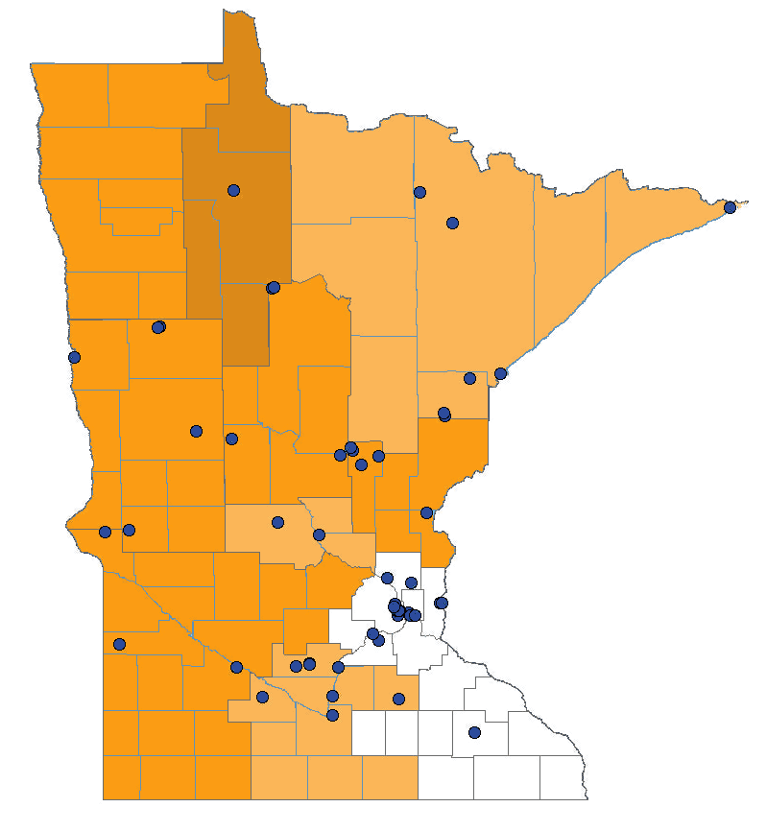
Shortage of behavioral health care professionals
MINNESOTA 2018
Geographic high needs area (orange;
darker color = more severe shortage)
Specific facility with shortage of behavioral health care professionals
(blue dots)
In correctional facilities
Current workforce
Shortage of behavioral health care professionals
Behavioral health care professionals:
psychiatrists, clinical psychologists, clinical social workers, psychiatric nurse specialists, and marriage & family therapists
Facilities:
Federal & state correctional institutions, state & county mental hospitals, community mental health centers, and other public or nonprofit private facilities
Geographic high needs area based on population-to-provider ratio, poverty levels, elderly and youth ratio, alcohol and substance abuse prevalence, and travel time to nearest source of care outside area
Source: Health Professional Shortage Areas (HPSA), HRSA Data Warehouse, 03/16/2018

Slide 18
State population in behavioral health care professional shortage areas
MINNESOTA AND UNITED STATES 2018
Source: Health Professional Shortage Areas (HPSA), HRSA Data Warehouse, 03/16/2018, and Census Bureau data (2017)

Slide 19
MENTAL HEALTH CONDITIONS & THE CRIMINAL JUSTICE SYSTEM

Slide 20
Mental health issues in prison and jail populations
UNITED STATES
Source: National Survey of Drug Use and Health (NSDUH) 2016
Bureau of Justice report: Sexual Victimization in Prisons and Jails Reported by Inmates, 2011-12,
based on data from the National Inmate Survey

Slide 21
Contact with criminal justice system
UNITED STATES 2016
# of times arrested & booked
Source: National Survey of Drug Use and Health (NSDUH) 2016
Survey does not include current institutionalized population

Slide 22
Change in treatment before and during incarceration in prison and jails
UNITED STATES
Counseling
Source: SISFCF (Survey of inmates in states and federal correctional facilities) 2004 &
SILJ (Survey of inmates in local jails) 2002

Slide 23
Based on the most recent data (from 2004),
we estimate that the number of
Minnesota state prison inmates in 2016,
previously diagnosed with serious mental illness was
3,732
Estimate of overall annual costs in 2016:
$228,823,173
Overall annual costs based on 2016 average of all state prison inmates in Minnesota
Source: Annual Survey of State Government Finances 2016
Survey of Inmates in State/Federal Correctional facilities, BJS, 2004
Minnesota State, Department of Corrections Adult Inmate Profile FY 2016

Slide 24
Economic burden of serious mental illness
MINNESOTA 2016
Source: MacEwan JP, Seabury S, et al. Pharmaceutical innovation in the treatment of schizophrenia and mental disorders compared with other diseases. Innov Clin Neurosci. 2016 Aug 1;13(7-8):17-25. See appendix for original sources

Slide 25
Lost productivity is the largest contributor to economic burden of serious mental illness
UNITED STATES
Medical costs
Lost productivity
Other costs
Lost productivity: unemployment, lost compensation (incl. caregivers), or early mortality.
Medical costs: also includes substance abuse treatment
Other costs: law enforcement, incarceration, shelters, and research & training.
Source: MacEwan JP, Seabury S, et al. Pharmaceutical innovation in the treatment of schizophrenia and mental disorders compared with other diseases. Innov Clin Neurosci. 2016 Aug 1;13(7-8):17-25. See appendix for original sources

Slide 26
Email: heunjohn@usc.edu

