Slide 1

Federal Policy Update
National Council for Behavioral Health
May 3, 2018

Slide 2
FY 2018 Appropriations
Massive omnibus spending bill passed in March
  +$10.1 billion for federal health spending
    SAMHSA, NIH, CDC receive increases
    $4 billion dedicated to addressing opioid crisis
  Key programs:
    CCBHCs (+$100 million)
    PIPBHC (level funding)
    Mental Health First Aid (+$5 million)
    Opioid STR grants (doubled to $1 billion)
    And more!

Slide 3
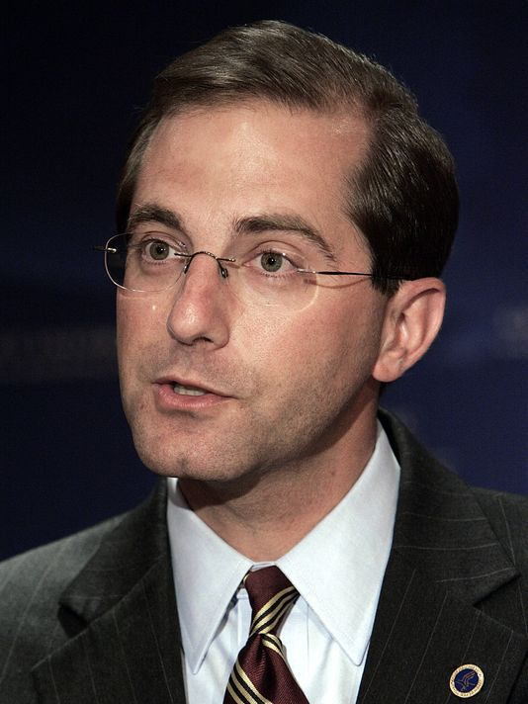

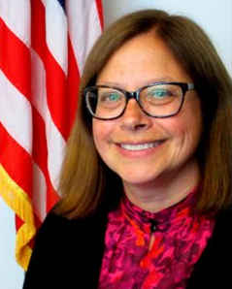
Trump’s Health Care Team
Alex Azar,
Secretary of HHS
Seema Verma, Administrator of CMS
Dr. Elinore McCance-Katz, Assistant Sec. for Mental Health
Notes:
Tom Price - Chairman of the House Budget Committee
Orthopedic surgeon by training
Longtime opponent of the Affordable Care Act.
He was just elected to his 7th term in Congress.

Slide 4

Likely Medicaid waiver proposals
Work requirements
Drug testing
Higher cost sharing
Use of HSAs
Special enrollment &
lockout periods
Time limit on coverage
“Disability” is often touted as a category of exemption from new waiver requirements.
Notes:
“Disability” as a category for exemption
Does not include people with addiction
Does not include people with moderate-severity conditions accompanied by cognitive impairments
“Medically frail” may be a better exemption category
Education of policymakers is needed!

Slide 5



Medicaid Work Requirements
CMS released guidelines for states to create work requirements
At least 10 states have submitted waivers
Proposals approved in Kentucky, Indiana, Arkansas
  Non-exempt individuals must complete 20+ hrs/week of work, job training, job search or “community engagement” activities
  Lawsuit pending against HHS & CMS

Slide 6
House and Senate Opioid-Related Legislation
  Reauthorize the Opioid State Targeted Response Grant Program
  Make medication-assisted treatment (MAT) available via telemedicine
  Increase access to MAT with more prescribers
  Require HHS to issue guidance on recovery housing best practices
  Spur development for new pain & addiction treatments
  And a lot more …

Slide 7

Questions?

