Slide 1
THE COST OF MENTAL ILLNESS:
ILLINOIS FACTS AND FIGURES
2018 Update

Slide 2


ACKNOWLEDGMENTS
Authors: Hanke Heun-Johnson, Michael Menchine, Dana Goldman, Seth Seabury
Funding for this project was provided through an unrestricted grant from Alkermes.
This work was done as part of the Keck-Schaeffer Initiative for Population Health Policy.
We also acknowledge comments and contributions to this work from the
National Council for Behavioral Health and the Behavioral Health + Economics Network.
References, data sources and methods are described in more detail in the online appendix.
The final version of this chartbook and the appendix can be downloaded at:
http://healthpolicy.usc.edu/Keck_Schaeffer_Initiative.aspx

Slide 3
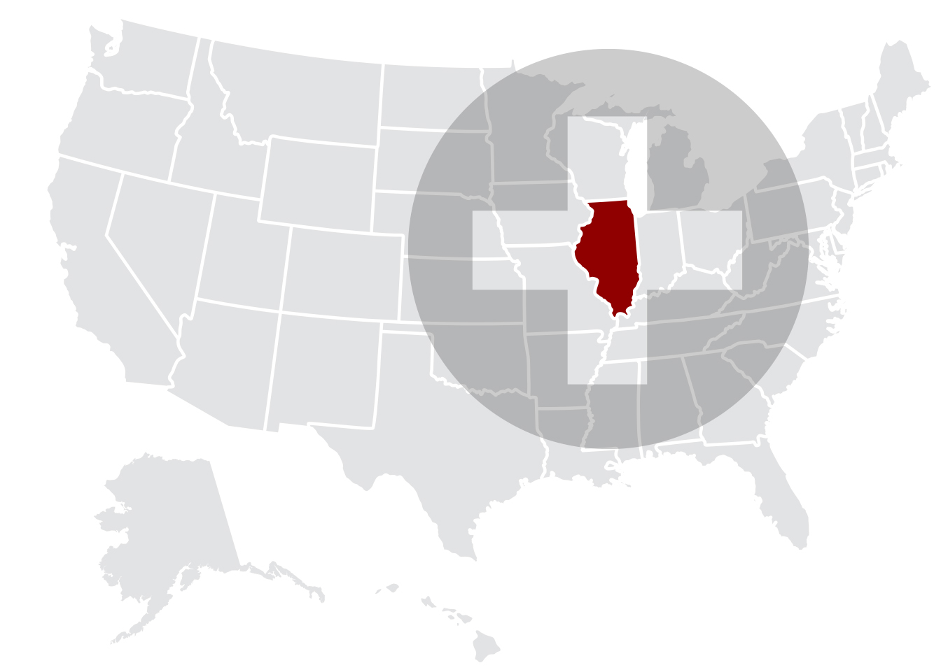
ILLINOIS

Slide 4
INTRODUCTION
Improving access to high-quality medical care for patients with mental illness remains one of the most vexing problems facing the healthcare system in the United States.
Illinois is no exception, with some commentators reporting a mental health care “crisis” in the state.
We report data on the magnitude of the challenges facing Illinois in terms of the economic burden associated with mental illness, including:
  The size of the mentally ill population
  The unmet need in terms of mental health providers
  Struggles maintaining a behavioral health workforce
  The high rates of hospitalization
  The cost of serious mental illness in Illinois
¹ http://www.chicagotribune.com/suburbs/daily-southtown/opinion/ct-sta-kadner-mental-st-0529-20150528-story.html

Slide 5
QUANTIFYING THE POPULATION LIVING WITH MENTAL ILLNESS IN ILLINOIS AND THE U.S.

Slide 6
Prevalence of mental illness
UNITED STATES 2016
Many mental health
conditions are fairly
common in the general
population.
Whereas any of these conditions can severely limit someone’s normal daily activities, three disorders are often labeled as
serious mental illness:
major depressive disorder, bipolar disorder and
schizophrenia. These three disorders will be the focus of this chartbook.
NB: Due to symptom overlap, diagnoses of mental illnesses are not mutually exclusive
Source: National Survey on Drug Use and Health (NSDUH) 2016 (SPD), NSDUH Mental Health Surveillance Study 2008-2012 (major depressive disorder) and National Institutes of Mental Health (other conditions – see appendix for original sources)

Slide 7
Estimated number of people living with mental illness
ILLINOIS 2016
We estimate that more than one million adults in Illinois experienced serious psychological distress in the past 12 months.
Note that a patient can receive multiple diagnoses of a serious mental illness due to a high degree of overlap between the mental health conditions.
Source: National Institutes of Mental Health, National Survey on Drug Use and Health (NSDUH) 2016, and NSDUH-MHSS 2008-2012. Estimated number of people affected using total state population of 9,878,820 adults (18 years and over), Census Bureau data (2016)

Slide 8
There is significant unmet need for mental health care in the U.S.
UNITED STATES 2016
Among adults who experienced
serious psychological distress
during the past year:
More than a quarter of adults who experienced serious psychological distress in the previous year in the U.S. reported an unmet need for mental health care. Almost half of the people with a perceived unmet need reported that they did not receive treatment because they could not afford it.
Unmet
need:
27.3%
Cannot
afford:
41.3%
27.3% indicates an unmet need of mental health treatment
Source: National Survey on Drug Use and Health (NSDUH) 2016

Slide 9
Unmet need of mental health treatment due to costs
UNITED STATES 2016
The extent to which cost was a factor in driving unmet need for mental health care varied by insurance status. People without health insurance were most affected by the inability to afford mental health treatment (75%), while those with VA/military health insurance coverage were least affected (13%).
Source: National Survey on Drug Use and Health (NSDUH) 2016

Slide 10
People with mental illness have greater reliance on the safety net
UNITED STATES 2016
In the Medicaid and uninsured population, a higher percentage of people reported serious psychological distress (SPD) during the past year compared to people with Medicare, VA/military, or private health insurance coverage.
Percentage of people with
serious psychological distress
by insurance type
Source: National Survey on Drug Use and Health (NSDUH) 2016

Slide 11
Medicaid reimbursement rates to physicians are low
ILLINOIS AND UNITED STATES 2016
From 2014 to 2016, the fee ratio rose nationally from 0.66 to 0.72, but in IL it fell from 0.62 to 0.61.
Low reimbursement rates are a disincentive for individual physicians to accept patients with Medicaid coverage and mental health problems. Compared to Medicare fee levels, Medicaid reimbursement rates are low in most states.
Illinois has one of the lowest Medicaid-to-Medicare fee ratios, which may further limit physician’s willingness to accept Medicaid patients. This can be a barrier for these patients to obtain access to mental health care.
Source, Kaiser Family Foundation, Medicaid-to-Medicare Fee Index, FY 2016

Slide 12
State Mental Health Agency spending
UNITED STATES 2013
Illinois’s state mental health agency spends a very low per capita amount on mental health services, compared to the rest of the U.S.
Expenditures include (on average):
72% Community-based mental health programs funded and/or operated by state mental health agencies
26% Mental health services in state psychiatric hospitals
2% Administration/training/ research/evaluation to support these services
$127
Source:State Mental Health Agency-Controlled Expenditures for Mental Health Services, FY 2013 National Association of State Mental Health program Directors Research Institute, Inc (NRI)
Draft – subject to change

Slide 13
AVAILABILITY OF MENTAL HEALTH CARE PROVIDERS

Slide 14
Availability of behavioral health care professionals
ILLINOIS AND UNITED STATES 2017
There are 17 behavioral health care professionals for every 10,000 residents in Illinois, which is slightly lower than the average in the U.S.
Note that the U.S. average
does not represent the
optimal number of
behavioral health care
professionals.
Behavioral health care professionals include: psychiatrists, psychologists, licensed clinical social workers, counselors, marriage and family therapists, and advanced practice nurses specializing in behavioral health care.
This fell from 18.0 in 2016 (a 4% drop).
Source: County Health Rankings & Roadmaps, by the Robert Wood Johnson Foundation and the University of Wisconsin Population Health Institute.

Slide 15
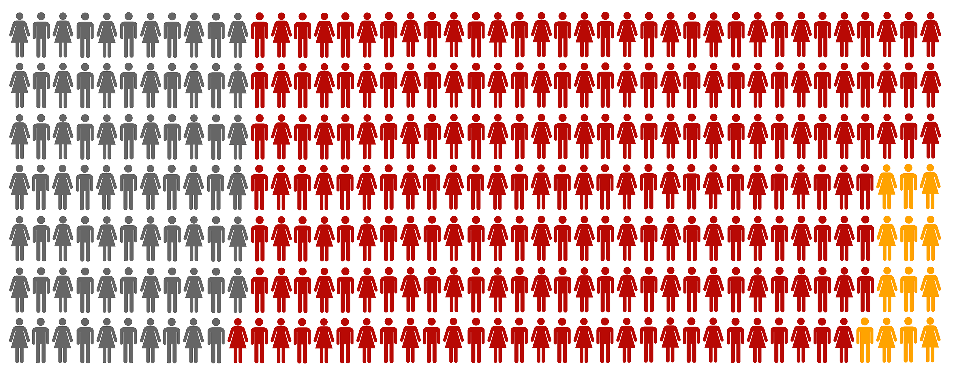
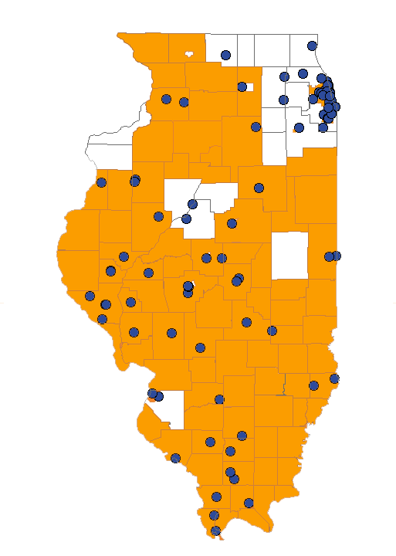
Shortage of behavioral health care professionals
ILLINOIS 2018
Currently, Illinois has 76 full-time equivalent behavioral health care professionals in designated shortage areas and facilities with behavioral health care professional shortages. In order to address the shortage issue, 225 more full-time professionals are needed in these areas, 13 of whom are needed in correctional facilities.
In correctional facilities
Current
workforce
Shortage of behavioral health care professionals
Chicago
Behavioral health care professionals:
psychiatrists, clinical psychologists, clinical social workers, psychiatric nurse specialists, and marriage & family therapists
Facilities:
Federal & state correctional institutions, state & county mental hospitals, community mental health centers, and other public or nonprofit private facilities
Geographic high needs area based on population-to-provider ratio, poverty levels, elderly and youth ratio, alcohol and substance abuse prevalence, and travel time to nearest source of care outside area
Geographic high needs area (orange)
Source: Health Professional Shortage Areas (HPSA), HRSA Data Warehouse data as of 3/18/2018
Specific facility with shortage of behavioral health care professionals
(blue dots)

Slide 16
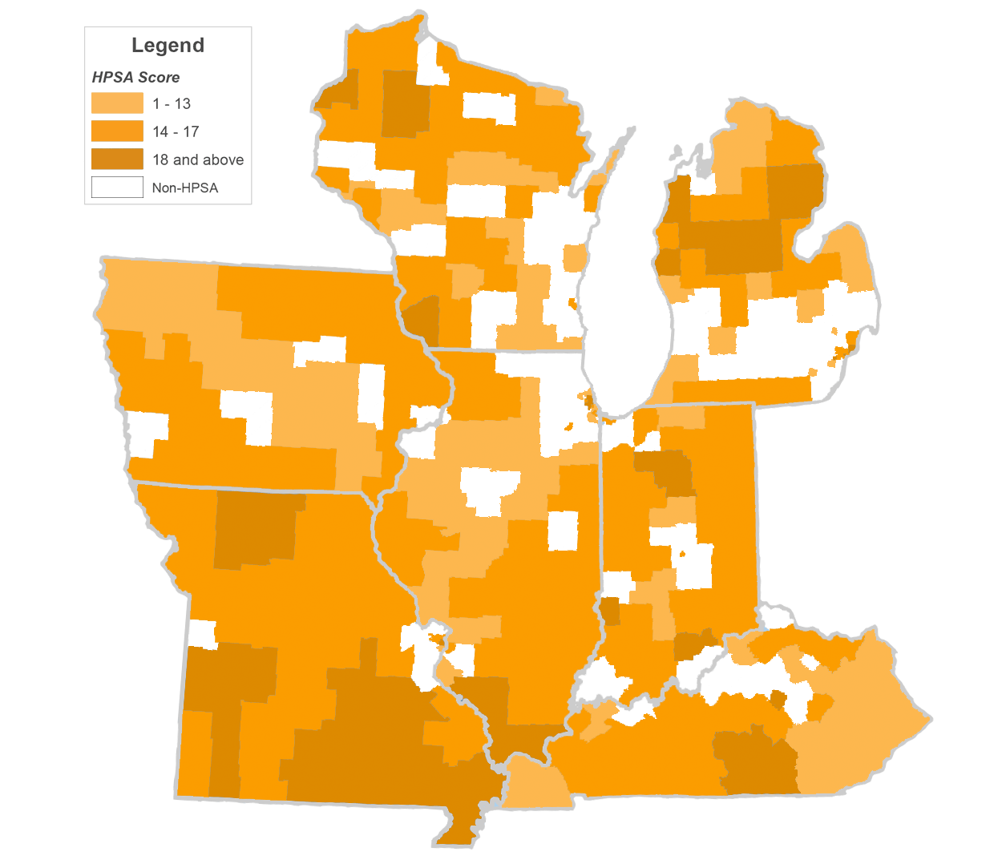
Shortage of behavioral health care professionals in the Illinois region
ILLINOIS 2018
Increase in shortage of behavioral health care professionals
2017-2018
The number of behavioral health care professionals needed to remove the shortage designation in Health Professional Shortage Areas is high in all states surrounding Illinois, especially in rural areas. However, Illinois has seen the highest increase in these shortages between 2017 and 2018.
The severity of the shortage on this map is measured on the Health Professional Shortage Area scale from 0 to 25, with 0 indicating no shortage, and 18 and above a severe shortage.
Wisconsin
+15%
Michigan
+58%
Iowa
+50%
Indiana
+90%
Illinois
+201%
Missouri
+59%
Kentucky
+81%

Slide 17
State population in behavioral health care professional shortage areas
ILLINOIS AND UNITED STATES 2018
4,887,262 people in Illinois (38% of the state population) reside in designated shortage areas and/or are served by a facility with shortages of behavioral health care professionals. This is higher than the U.S. average of 30%.
Source: Health Professional Shortage Areas (HPSA), HRSA Data Warehouse, 03/16/2018, and Census Bureau data (2017)

Slide 18
MENTAL HEALTH CARE UTILIZATION
& COSTS

Slide 19
Hospitalizations for mental illness
ILLINOIS AND UNITED STATES 2014
In Illinois, the number of hospitalizations of adults with schizophrenia, bipolar disorder, and major depressive disorder are approximately equal. However, patients with schizophrenia have a much higher rate of hospitalizations.
Compared to the rest of the U.S., hospitalization rates in Illinois for adults with serious mental illness are approximately 1.5 times higher.
4.5 % of all hospitalizations are due to SMI
Source: Healthcare Cost and Utilization Project (HCUPnet) 2014
Estimate of hospitalization rate: based on total state population (Census bureau data, 2014) and prevalence estimates reported previously

Slide 20
Trends in length of stay for schizophrenia hospitalizations
UNITED STATES 2001-2014
The average length of stay for a schizophrenia hospitalization was longer than those for kidney transplants, heart attacks or hip replacement surgeries. Moreover, the average duration for these other conditions all declined by at least 18% from 2000 to 2014 while for schizophrenia the duration increased slightly.
-21%
-18%
-38%
Source: Health Care Utilization Project (HCUPnet) 2014
Draft – subject to change

Slide 21
Total hospital costs for serious mental illness hospitalizations by insurance type
ILLINOIS 2014
Total hospital costs
(all ages, in 2016 U.S. $)
Compared to all hospitalizations, the expected payer for hospitalizations involving serious mental illness is much more likely to be Medicaid and less likely to be Medicare or a private insurer.
Only a small fraction of the $349 million in total hospitalization costs is covered by other programs (including VA/military health insurance), or paid by patients without health insurance.
Source: Healthcare Cost and Utilization Project (HCUPnet) 2014.
‘Other’ includes Worker's Compensation, TRICARE/CHAMPUS, CHAMPVA, Title V, and other government programs. ‘Uninsured’ includes ‘self-pay’ and ‘no charge’.

Slide 22
MENTAL HEALTH CONDITIONS & THE CRIMINAL JUSTICE SYSTEM

Slide 23
Contact with criminal justice system
UNITED STATES 2016
People who experienced serious psychological distress (SPD) are more likely to have been arrested or be on parole or probation in the past year.
# of times arrested & booked
Source: National Survey of Drug Use and Health (NSDUH) 2016
Survey does not include current institutionalized population

Slide 24
Mental health issues in prison and jail populations
UNITED STATES
A large percentage of the U.S. prison and jail inmate population currently experiences Serious Psychological Distress compared to the non-institutionalized population.
Additionally, these mental health issues are observed at higher rates in local jails than in prisons.
Source: National Survey of Drug Use and Health (NSDUH) 2015
Bureau of Justice report: Sexual Victimization in Prisons and Jails Reported by Inmates, 2011-12,
based on data from the National Inmate Survey
Draft – subject to change

Slide 25
State prison population with Serious Mental Illness
UNITED STATES
The increase in mental health care treatment in federal and state prisons after admission to prison suggests that these institutions are making up for the gaps in mental health treatment in the regular health care system.
At the same time, local jail inmates do not have the same access to medication and counseling while incarcerated as federal and state prisoners.
Counseling
Mental health conditions include prior diagnosis of depressive disorder, bipolar disorder, and/or schizophrenia. Medication and counseling data includes treatment for any mental illness.
Source: SISFCF (Survey of inmates in states and federal correctional facilities) 2004 &
SILJ (Survey of inmates in local jails) 2002
Draft – subject to change

Slide 26
Estimated number of
Illinois state prison inmates in 2016,
previously diagnosed with serious mental illness:
8,202
Estimate of overall annual costs in 2016:
$ 193,276,365
(in 2016 U.S.$)
Overall annual costs based on 2016 average of all state prison inmates in Illinois
Source: Annual Survey of State Government Finances 2016
Survey of Inmates in State/Federal Correctional facilities, BJS, 2004
Illinois Department of Corrections - Fiscal Year 2016 Annual Report

Slide 27
TOTAL ECONOMIC BURDEN OF SERIOUS MENTAL ILLNESS

Slide 28
Economic burden of serious mental illness
UNITED STATES 2016
The economic burden of schizophrenia, bipolar disorder, and major depressive disorder in adults in the U.S. is estimated to be at least $35 billion for each serious mental illness
Due to symptom overlap, diagnoses of mental illnesses are not mutually exclusive, therefore, patients with two or more diagnoses may be represented in multiple categories.
Source: MacEwan JP, Seabury S, et al. Pharmaceutical innovation in the treatment of schizophrenia and mental disorders compared with other diseases. Innov Clin Neurosci. 2016 Aug 1;13(7-8):17-25. See appendix for original sources

Slide 29
Lost productivity is the largest contributor to economic burden of serious mental illness
UNITED STATES
Medical costs
Most of the total economic burden of serious mental illness is due to lost productivity (unemployment, lost compensation (incl. caregivers), or early mortality). Only 12 to 47% of the total burden is resulting from direct medical costs (including substance abuse treatment), and an even smaller percentage from law enforcement, incarceration, shelters, or research & training (other costs).
This highlights the large potential economic and societal benefits from improving treatment for serious mental illness even if it means spending more on care.
Lost productivity
Other costs
Source: MacEwan JP, Seabury S, et al. Pharmaceutical innovation in the treatment of schizophrenia and mental disorders compared with other diseases. Innov Clin Neurosci. 2016 Aug 1;13(7-8):17-25. See appendix for original sources

