Slide 1
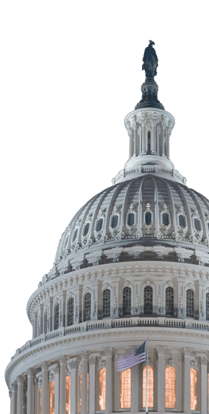
Federal Policy Update
National Council for Behavioral Health
May 18, 2018

Slide 2

News From Washington
FY2018 omnibus funding bill passed in March.
Various executive and legislative actions repeal or undercut portions of the ACA.
CMS moves to permit work requirements, other restrictions on Medicaid benefits.

Slide 3
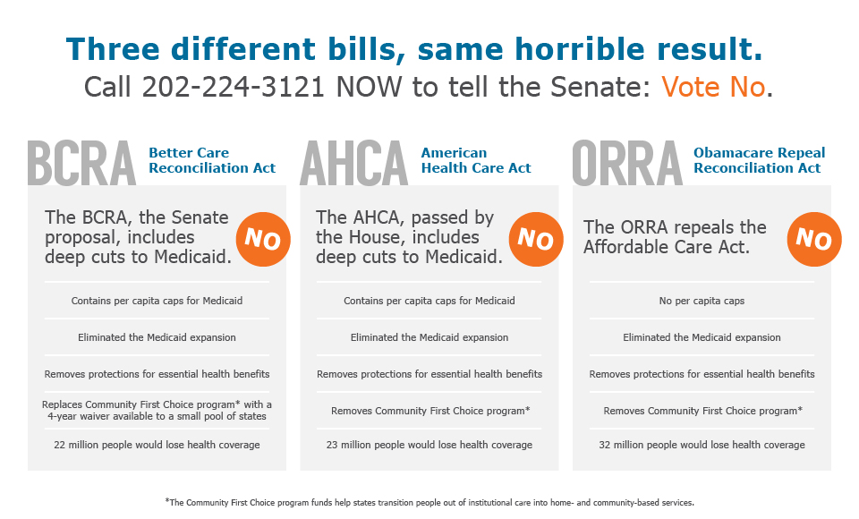
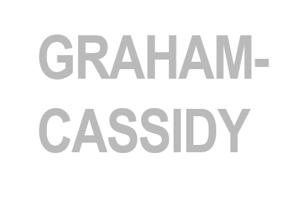

Where we’ve come…
Tax Cuts and Jobs Act (Senate version)
Repeals the individual mandate, leaving 13 million people without health insurance and raises premiums on insurance
Cuts Medicaid enrollment by 5 million Americans, Medicare by $25 billion
Also included major cuts to Medicaid &
commercial insurance, with devastating
impact on people with serious chronic conditions

Slide 4
Proposed Medicaid Changes
Repeal Medicaid expansion option
Phase out enhanced federal match rate for Medicaid expansion
Convert Medicaid to a per-capita capped or block grant system
Net effects:
  Cuts ~$880 billion from Medicaid over ten years
  Makes it expensive and complicated for states to continue Medicaid expansion

Slide 5
Proposed Commercial Market Changes
Establish waiver process for states to opt out of key ACA requirements:
Waiving essential health benefits
  Effect: States could permit the sale of plans that exclude key benefits, including MH/SUD care.
Waiving protections based on health and age
  Effect: States could allow insurers to charge people w/ pre-existing conditions and older people higher premiums, pushing some out of affordable coverage.

Slide 6

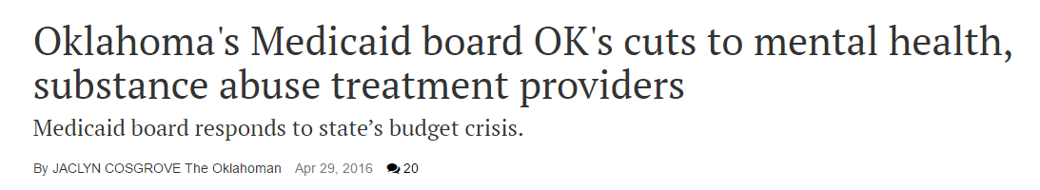
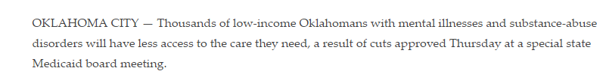
Medicaid reform proposals would further crunch states… and providers
25 states have general fund revenue shortfalls
Common cost-cutting actions include: provider pay cuts, enrollment limitations, benefit reductions

Slide 7



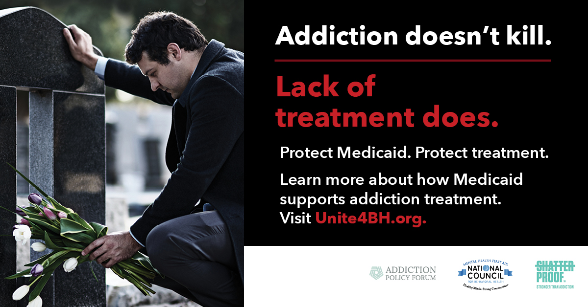

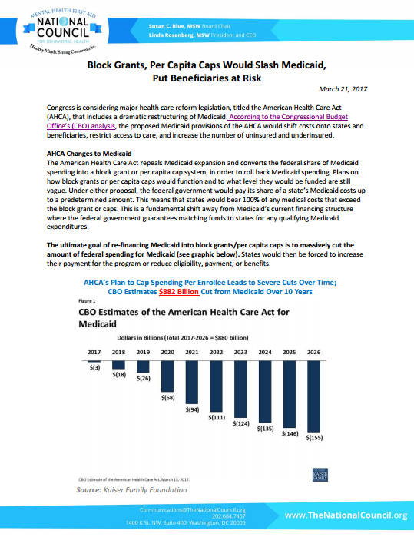



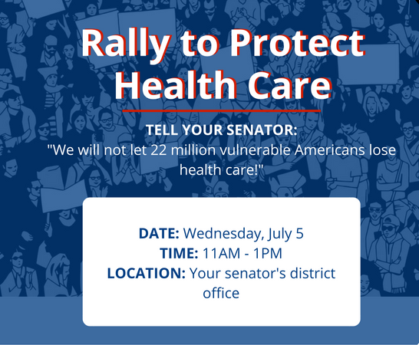
Unite4BH Rally Cry
91
Staff testified at 3 committee hearings &
staff briefings
Meetings held with Congressional offices by National Council staff & lobbyists
4,300+ advocates…
Have sent 15,000+ messages…
And made 3,000+ phone calls…
Reaching at least 498 legislators
22 State-specific Medicaid fact sheets
1 Medicaid expansion fact sheet
1 Medicaid block grant/ per-capita cap fact sheet
Print ads placed in 10 state & nat’l newspapers • Radio ads ran in 3 states
June 30, 2017
“When it comes to other illnesses like breast cancer or heart disease, we’d never rely solely on grants for treatment — because we know that grants are not substitutes for health coverage,” said Linda Rosenberg, president and chief executive of the National Council for Behavioral Health, which represents treatment providers. “Addiction is no different.”
#unite4bh
19.348M Impressions
3,899 Tweets
1,407 Participants
1 Avg Tweets/Hour
3 Avg Tweets/Participant
18 webinars
150 avg. attendees
44 unique press hits • 4 op-eds published
3 National Council statements
282,192,223 and counting…
14,316
unique views, Unite4BH website
Quotes appeared in: • New York Times • Washington Post • Stateline • Huffington Post • Vox • USA Today • Politico • Reuters • The Hill • CNN • NBC • Modern Healthcare • Bloomberg • VICE News • Behavioral Healthcare Magazine • and more…
Media impressions on stories where National Council member or staff were quoted

Slide 8
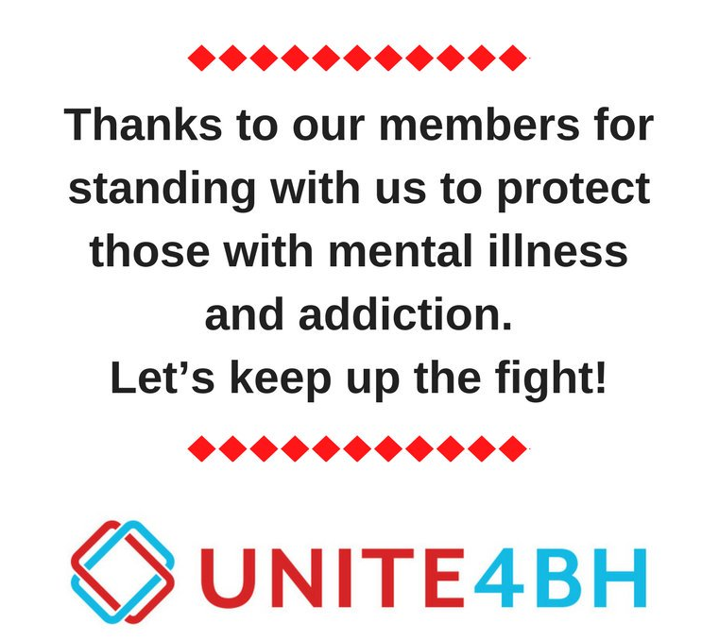

Slide 9
Where are we now?
TAX CUTS
FY ‘18/19 Appropriations
LIMITED COVERAGE HEALTH PLANS
STATE MEDICAID WAIVERS

Slide 10

Tax Cuts and Jobs Act of 2017
Impact on insurance markets
Repealed the ACA’s individual mandate
  Little impact expected on premiums in CY 2018
  Substantial premium increases expected in future years as healthy enrollees drop coverage
  Potentially opens door to smoother passage of future ACA repeal bill by reducing # of uninsured in CBO score?
Did you know: The tax bill also doubled the standard deduction, shifting incentives away from charitable giving, resulting in an projected $13.1 billion loss in giving.

Slide 11
FY 2018 Appropriations
Massive omnibus spending bill passed in March
  +$10.1 billion for federal health spending
    SAMHSA, NIH, CDC receive increases
    $4 billion dedicated to addressing opioid crisis
  Key programs:
    CCBHCs (+$100 million)
    PIPBHC (level funding)
    Mental Health First Aid (+$5 million)
    Opioid STR grants (doubled to $1 billion)
    And more!

Slide 12
FY 2019 Appropriations
President’s Budget Request
  Signaled support for bills that would end Medicaid expansion, convert Medicaid to block grants for states
  +$10 billion in discretionary spending for HHS to address the opioid crisis
  -$668 million cut to SAMHSA
  Almost zeroes-out Office of National Drug Control Policy budget
  +$1.4 billion for National Institutes of Health\
On to Congress for budget resolutions

Slide 13
Meanwhile, at the White House…
Action on CSRs, association health plans
Cost Sharing Reductions
Association Health Plans
  Plans to end $7B in subsidies that help low-income consumers purchase coverage
  Affects people 100-250% FPL in silver plans
  Insurers’ rates for 2018 already locked in
  The litigation begins…
  Reinterprets AHPs as ERISA plans (largely exempt from ACA EHB and coverage discrimination requirements)
  Allows sale of AHPs across state lines by employers in the same line of business
  Rulemaking required

Slide 14
Proposed changes to essential health benefits
Would open the door to less comprehensive EHB by allowing states to:
  Choose plans (and benefit categories) from other states
  Substitute one category of benefits for another
  Create a new benefit plan from scratch
HHS considering a “federal default definition of essential health benefits”
  Could include a “national benchmark plan standard” that would shift costs to states for more generous coverage

Slide 15

What do we know about
what’s ahead?
Notes:
This presentation is for the Indiana Council (State Association)

Slide 16
1
President Trump’s new health team is reshaping regulatory direction and action, with an emphasis on state “flexibility.”

Slide 17
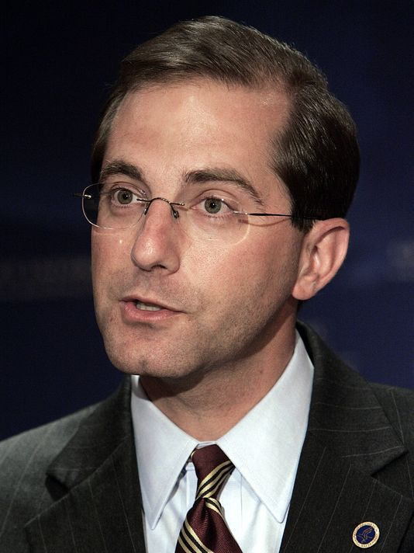

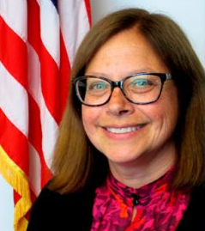
Trump’s Health Care Team
“Today, we commit to ushering in a new era for the federal and state Medicaid partnership where states have more freedom to design programs that meet the spectrum of diverse needs of their Medicaid population…”
–Former Sec. Tom Price & Administrator Seema Verma
Alex Azar,
Secretary of HHS
Seema Verma, Administrator of CMS
Dr. Elinore McCance-Katz, Assistant Sec. for Mental Health

Slide 18
Regulatory Areas of Focus
Medicaid Expansion and Work Requirements
  CMS recently released guidance allowing states to require Medicaid recipients to work, which marks a significant shift in the program.
  Several key policy decisions are still being contemplated within the Administration, including whether to allow “partial” Medicaid expansion or limits on eligibility.
The Future of CMMI
  CMS issued an informal request for information for CMMI, dubbed New Direction, to help shape its future work.
  CMMI could ostensibly be used to both: (1) introduce subtle changes in physician reimbursement and scale down mandatory demonstrations, and (2) be a tool for entitlement reforms and push for increased beneficiary accountability for cost of care.
Association Health Plans (AHPs) and Short-Term Plans
  The Trump Administration has been pushing regulations that would allow consumers to buy insurance plans that skirt many of the consumer protections included in the ACA.
  A rule on AHPs would allow employees in the same trade or geographic area to band together under the same rules that apply to large employers.
  Short-term plans are exempt from ACA regulations, and under new rules, could be renewed annually.

Slide 19
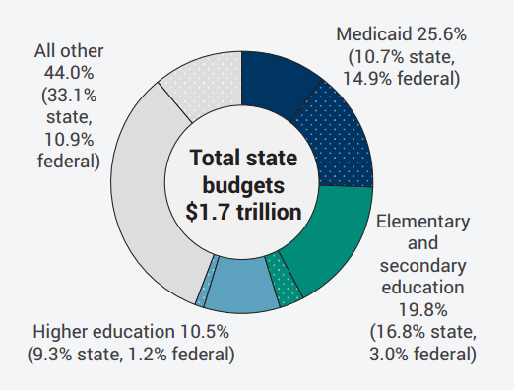
States rely heavily on federal Medicaid funding

Slide 20




State Medicaid Buy-In Proposals
Reaction to ACA Repeal efforts
Could expand Medicaid by allowing individuals not currently eligible to buy into public coverage
Need to seek federal approval to offer subsidies
Notes:
Advantages:
Large, statewide provider networks
Overall reach of the programs
States would have flexibility to set plan rates
Disadvantages:
Medicaid’s lower provider reimbursement rates could diminish provider participation
May not be politically feasible to broaden Medicaid

Slide 21
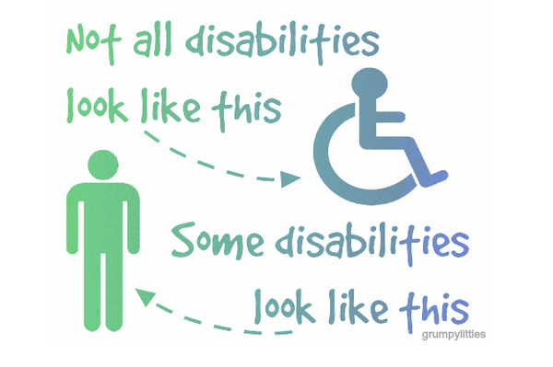
Likely Medicaid waiver proposals
Work requirements
  10 states submitted waivers
  KY, IN, AR approved
  Litigation
Drug testing
Higher cost sharing
Use of HSAs
Special enrollment &
lockout periods
Time limit on coverage
  CMS rejected KS lifetime limit on coverage
“Disability” is often touted as a category of exemption from new waiver requirements.
Notes:
“Disability” as a category for exemption
Does not include people with addiction
Does not include people with moderate-severity conditions accompanied by cognitive impairments
“Medically frail” may be a better exemption category
Education of policymakers is needed!
Work requirements: Non-exempt individuals must complete 20+ hrs/week of work, job training, job search or “community engagement” activities

Slide 22
Shift in CMMI Focus
2016 Focus Areas:
Implementation of models
Monitoring & optimizing results
Evaluation & scaling of models
Integrating innovation across CMS
Development of new models to round out portfolio
2017 Focus Areas:
Reducing administrative & regulatory burdens
Increasing focus on voluntary models
Seeking industry-driven innovations
Promoting provider choice and competition
Eliminating unsuccessful models

Slide 23
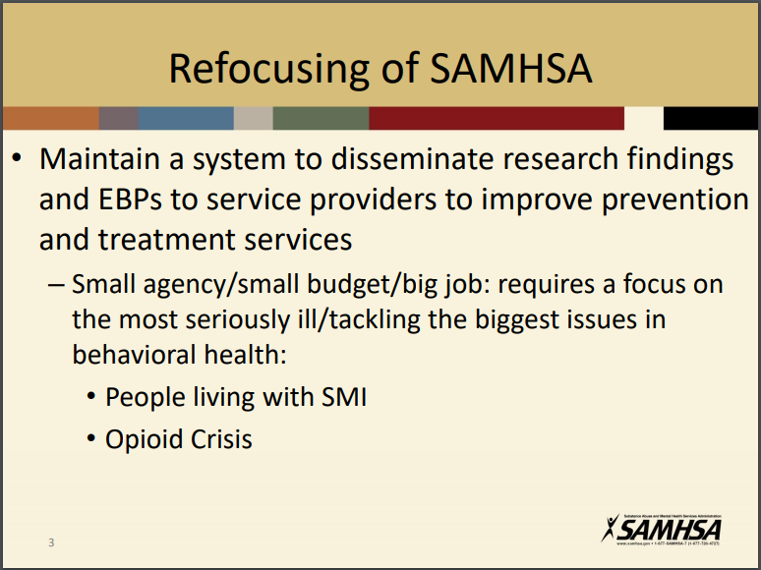
SAMHSA priorities

Slide 24
ISMICC Recommendations
Strengthen federal coordination
Increase access to care
Address workforce shortage
Close the gap between what works and what is offered
Increase criminal justice diversion & early intervention

Slide 25
Potential Solutions
Certified Community Behavioral Health Clinics (CCBHCs)
  2-year demo in 8 states
  Increased access to services by 25% in first 6 months
Payment reform
Mental Health First Aid (MHFA)

Slide 26
2
There is continued interest in Congress in addressing addiction and mental health.

Slide 27
Opioid Legislation
One of the few issues in health care that has the potential to break through for the reminder of the election year is opioid-related legislation.
  The House Energy and Commerce Health Subcommittee is holding a series of hearings on opioid legislation, and Health Subcommittee Committee Chairman Greg Walden (R-OR) is aiming to get a House vote on a package of bills by Memorial Day.
  In the Senate, the HELP and Finance Committees are pursuing a parallel effort to the House, but have been moving at a slower pace thus far.
  Sens. Rob Portman (R-OR) and Sheldon Whitehouse (D-RI) are working on their own opioid-related measure, framing it as a follow-up bill to the Comprehensive Addiction and Recovery Act (CARA) signed into law in 2016.

Slide 28
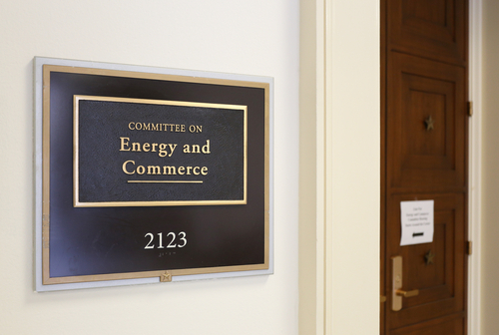
House Response
Energy & Commerce is in the midst of hearings to consider dozens of bills with various solutions:
  Telehealth
  Alternatives for pain management
  IMD exclusion
  Recovery housing best practices
  Research
  Grant-funded services
  SUD Workforce
  Incentivize EHR use

Slide 29
Senate Response
Senate Health, Education, Labor, & Pensions (HELP) Committee working on large package of legislation dubbed the “Opioid Crisis Response Act” that would:
  Reauthorize the Opioid State Targeted Response Grant Program
  Make medication-assisted treatment (MAT) available via telemedicine
  Increase access to MAT with more prescribers
  Require HHS to provide guidance on recovery housing best practices
  Spur development for new pain & addiction treatments
  Promotes the substance use disorder treatment workforce through loan forgiveness opportunities

Slide 30
Other Recent Legislation
  Excellence in Mental Health and Addiction Treatment Expansion Act: More states allowed to implement CCBHCs
  Mental Health Access Improvement Act: Medicare billing for MFTs/MHCs
  Multiple loan forgiveness bills for professionals in addiction settings
  Behavioral Health IT Act: Demonstration to help BH providers adopt electronic health records
  Other bills introduced: CARA 2.0, CHRONIC Care Act, Medicaid CARE Act, Telehealth proposals
Notes:
NOTE: CAVEAT…
Investment via grants, not coverage
Need for health-related “moving vehicles” to pass any of these bills

Slide 31

Caveats
Changes to other federal programs undermine other safety net supports
Investment via grants, not coverage
New rescission package threatens federal spending
  Would rescind $15.4 billion, including $7 billion from CHIP
Need for health-related “moving vehicles” to pass any of these bills

Slide 32
3
“Quality” and “Value” are still the buzzwords of the day… but there are conflicting signals from the federal gov’t about its investment in pursuing delivery and payment reform

Slide 33
Shifting Focus from Volume to Value
Capitation
Value
Shared Savings
Episodic Bundles
Pay for Performance
Volume (FFS)
Incentives for health system investment in behavioral health care
Reduce ED overcrowding
Improve bed availability
Reduce inpatient length of stay
Prevent unnecessary readmissions
Improve clinical outcomes & reduce cost of care for complex, chronically ill populations
Notes:
In most of these payment models, there is very little downside risk
Understandable for the early years of an experiment, need to get lots of people to participate
This is slowly changing

Slide 34

Fad, or future?
“ACOs reduced spending by $836 million in 2016, nearly double the amount they posted in 2015.”
$
CMS backed away from publicizing its findings—an indication of changing commitment, or the result of a tumultuous administrative transition?
Notes:
2017 data: CMS QUIETLY POSTS ACO RESULTS — Three groups of accountable care organizations generated a combined $836 million in gross savings last year, nearly double the amount they posted 2015. It's a promising sign for one of the government's chief initiatives aimed at encouraging better and more efficient health care. But you'd be forgiven for missing it: CMS didn't publicly announce the results, POLITICO's Adam Cancryn writes.
Unlike in years past, the agency has no plans to tout the results of the program which was started by the Obama administration and is under review as part of a planned reimagining of its Innovation Center initiatives. And in a statement to POLITICO, a spokesperson downplayed the savings, noting they don't reflect "spillover effects of ACOs on the market" as well as $701 million in bonus payments to high-performing ACOs participating in the Medicare Shared Savings Program.
... Accounting for those payments, CMS still appears to have seen net savings from the program. But it's unclear whether the agency paid out additional bonuses to organizations outside the Shared Savings Program.
The spokesperson added that CMS is taking a second look at all its innovation center models and the ACO portfolio — which includes the Shared Savings Program and Pioneer, Next Generation and Comprehensive ESRD Care models that together counted 471 participating ACOs in 2016.
CMS did not respond to questions about why it decided not to publicize the program's results this year.
2015 data: Medicare ACOs saved nearly $500 million last year - Medicare's accountable care organizations reduced spending by $466 million in 2015, according to fresh data from CMS. The 392 organizations enrolled in the Medicare Share Savings program cut spending by $429 million, while the dozen groups in the Pioneer ACO program saved $37 million. Among both groups, 125 ACOs - or 30 percent of the total - reduced spending enough to qualify to receive a share of the savings. On the downside: nearly half of participants didn't achieve any savings. CMS officials stressed that ACOs get better at hitting savings targets the longer they're enrolled in the programs. Among the ACOs in the Shared Savings program that started in 2012, 42 percent generated savings large enough to qualify for payments, compared to just 21 percent for those that joined the program in 2015.
the significant cost savings from ACOs means that they will continue to be a focus of policymaking and payment reform moving forward; and
success in an ACO model is not guaranteed – it comes with growing pains and real risk of failure, which is why CBHOs need to be well prepared to partner, coordinate, share info, and collect data!

Slide 35
4
What can YOU do? Advocate!

Slide 36
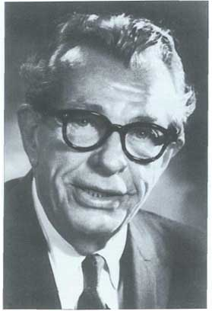
As former Senate Majority Leader Everett Dirksen (R-IL) said…
“When I feel the heat, I see the light.”

Slide 37

Questions?

