Slide 1
THE COST OF MENTAL ILLNESS:
KANSAS FACTS AND FIGURES

Slide 2



ACKNOWLEDGMENTS
Authors:
Funding for this project was provided through an unrestricted grant from Alkermes. Goldman and Seabury are consultants to Precision Health Economics, LLC and Goldman holds equity (<1%) in its parent firm.
This work was done as part of the Keck-Schaeffer Initiative for Population Health Policy.
We also acknowledge comments and contributions to this work from the
National Council for Behavioral Health and the Behavioral Health + Economics Network.
References, data sources and methods are described in more detail in the online appendix.
This chartbook and the appendix can be downloaded at:
http://healthpolicy.usc.edu/Keck_Schaeffer_Initiative.aspx
Hanke Heun-Johnson, PhD | Michael Menchine, MD, MPH | Dana P. Goldman, PhD | Seth A. Seabury, PhD

Slide 3
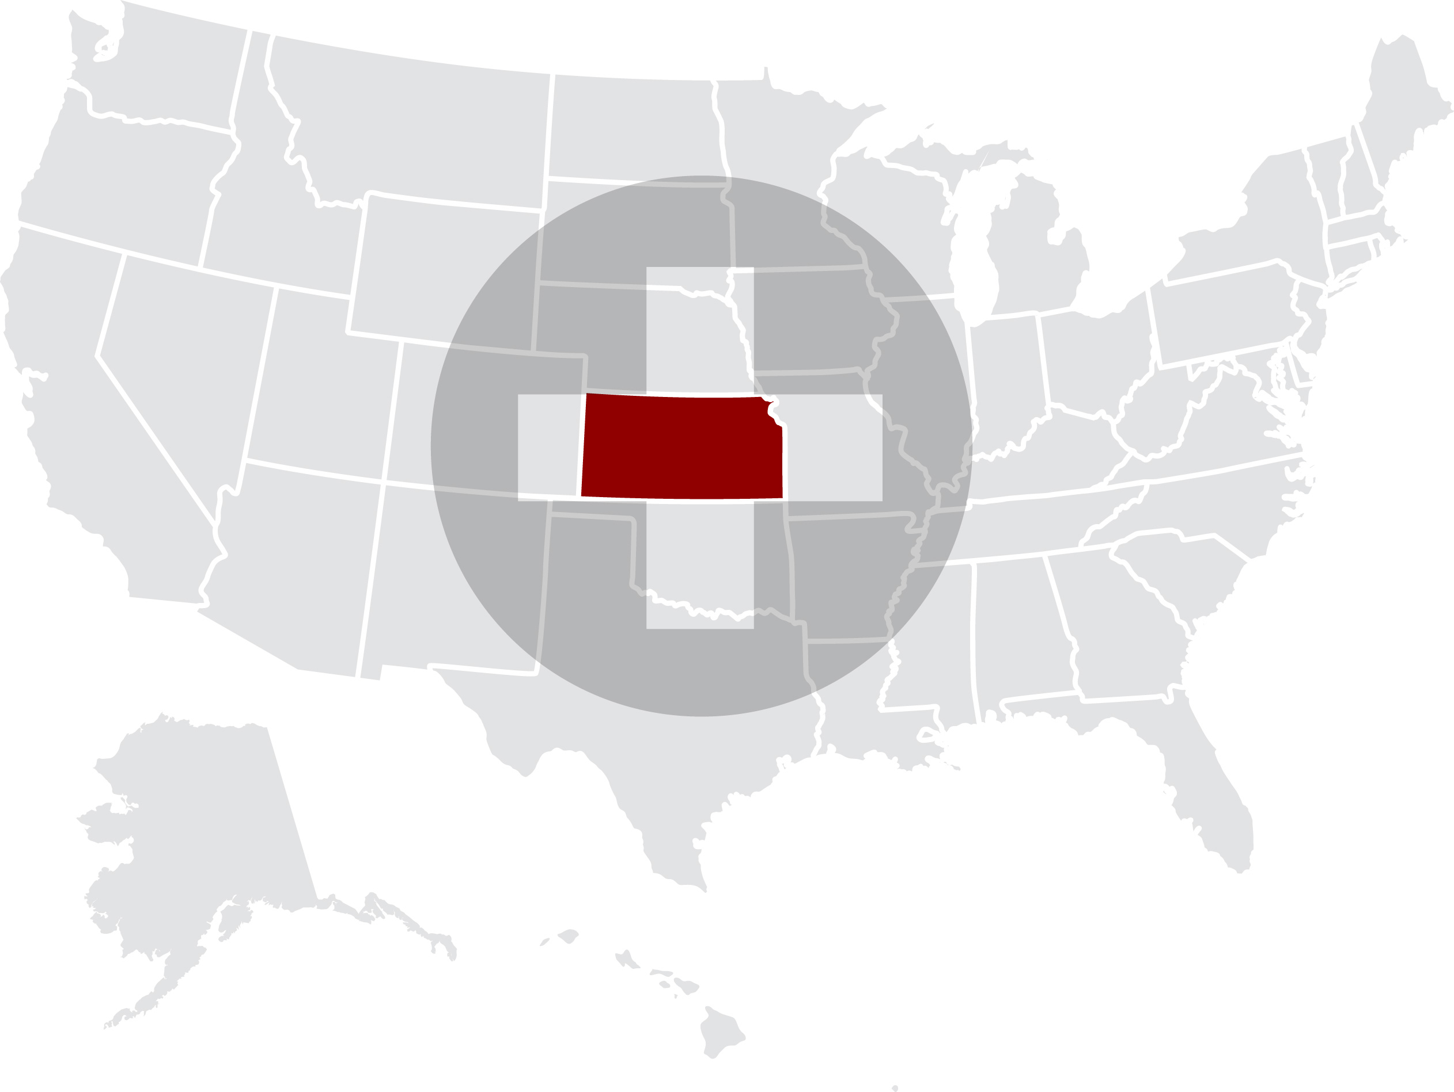
KANSAS

Slide 4
INTRODUCTION
Improving access to high-quality medical and behavioral health care for patients with mental illness remains one of the most vexing problems facing the healthcare system in the United States.
In Kansas, there is concern that access to affordable mental health care has been hampered by the state’s fiscal issues and policy decisions.
This chartbook quantifies the economic burden in Kansas associated with behavioral health issues.
We describe the population with serious mental illness and show the impact on the health care system based on high rates of hospitalization.
We also note the unmet need in terms of behavioral health care professionals and discuss the implications for the criminal justice system in Kansas.

Slide 5
QUANTIFYING THE POPULATION LIVING WITH MENTAL ILLNESS IN ILLINOIS AND THE U.S.

Slide 6
Prevalence of mental illness
UNITED STATES 2016
Many mental health
conditions are fairly
common in the general
population.
Whereas any of these conditions can severely limit someone’s normal daily activities, three disorders are often labeled as
Serious Mental Illness:
major depressive disorder, bipolar disorder and
schizophrenia. These three disorders will be the focus of this chartbook.
NB: Due to symptom overlap, diagnoses of mental illnesses are not mutually exclusive
Source: National Survey on Drug Use and Health (NSDUH, R-DAS) 2015-2016 (SPD), NSDUH Mental Health Surveillance Study 2008-2012 (major depressive disorder) and National Institutes of Mental Health (other conditions – see appendix for original sources)

Slide 7
Estimated number of people living with mental illness
KANSAS 2016
An estimated 220,000 adults in Kansas experienced serious psychological distress in the past 12 months.
Note that a patient can receive multiple diagnoses of a serious mental illness due to a high degree of overlap between the mental health conditions.
Source: National Institutes of Mental Health, National Institutes of Mental Health, National Survey on Drug Use and Health (NSDUH, R-DAS) 2015-2016, and NSDUH-MHSS 2008-2012. Estimate of # of people affected using total state population of 2,191,407 (18 years and over), Census Bureau data (2015)

Slide 8
MENTAL HEALTH CARE COVERAGE, UTILIZATION
& COSTS
Unmet mental health care needs
Approximately a quarter of adults with serious psychological distress in the past year reported an unmet need for mental health care. A common reason for not receiving care was the inability to afford mental health treatment, especially for people who do not have health insurance.

Slide 9
There is significant unmet need for mental health care in Kansas
KANSAS 2016
Among adults who experienced
serious psychological distress
during the past year:
Among adults who experienced serious psychological distress in the previous year in Kansas, a fifth reported an unmet need for mental health care.
Half of the people with a perceived unmet need reported that they did not receive treatment because they could not afford it.
Unmet
need:
24.2%
Cannot
afford:
57.7%
24.2% indicates an unmet need of mental health treatment
Source: National Survey on Drug Use and Health (NSDUH, R-DAS) 2015-2016

Slide 10
Unmet need of mental health treatment due to costs
KANSAS AND UNITED STATES 2016
In Kansas, 58% of people with serious psychological distress and an unmet need of mental health treatment, did not receive this treatment due to costs.
Source: National Survey on Drug Use and Health (NSDUH, R-DAS) 2015-2016

Slide 11
Unmet need of mental health treatment due to costs differs by insurance coverage
UNITED STATES 2016
On a national level, the extent to which cost was a factor in driving unmet need for mental health care among those with serious psychological distress, varied by insurance status. People without health insurance were most affected by the inability to afford mental health treatment (75%), while those with VA/military health insurance coverage were least affected (13%).
Source: National Survey on Drug Use and Health (NSDUH) 2016

Slide 12
People with mental illness have greater reliance on the safety net
KANSAS 2016
In the Medicaid and uninsured population, a higher percentage of adults in Kansas reported serious psychological distress (SPD) during the past year compared to people with Medicare, VA/military, or private health insurance coverage.
Percentage of adults with
serious psychological distress
by insurance type
Source: National Survey on Drug Use and Health (NSDUH, R-DAS) 2015-2016

Slide 13
Medicaid reimbursement rates to physicians are low
KANSAS AND UNITED STATES 2016
Low reimbursement rates are a disincentive for individual physicians to accept patients with Medicaid coverage and mental health problems. Compared to Medicare fee levels, Medicaid reimbursement rates are low in most states, including Kansas.
This can be a barrier for these patients to obtain access to mental health care.
Source, Kaiser Family Foundation, Medicaid-to-Medicare Fee Index, FY 2016

Slide 14
MENTAL HEALTH CARE UTILIZATION
& COSTS

Slide 15
Hospitalizations for mental illness
KANSAS 2014
In Kansas, the total number of hospitalizations is highest for adult patients with a principal diagnosis of major depressive disorder, whereas patients with schizophrenia disorder have a much higher rate of hospitalizations.
Compared to rest of the U.S., hospitalization rates in Kansas are slightly higher for patients with major depressive or bipolar disorder, but much lower for those with a diagnosis of schizophrenia.
3.4% of all hospitalizations in Kansas are due to SMI
Source: Healthcare Cost and Utilization Project (HCUPnet) 2014
Estimate of hospitalization rate: based on total state population (Census bureau data, 2014) and prevalence estimates reported previously

Slide 16
Length of stay for mental illness hospitalizations
KANSAS AND UNITED STATES 2014
The average hospital stay duration for adult patients with serious mental illness is relatively low in Kansas compared to the rest of the U.S., but remains higher than the average stay in a hospital for any diagnosis.
The total time spent in the hospital by adults with a primary diagnosis of serious mental illness is approximately 50,000 days each year in Kansas.
Source: Healthcare Cost and Utilization Project (HCUPnet) 2014

Slide 17
Trends in length of stay for schizophrenia hospitalizations
KANSAS 2000-2014
The average stay for a schizophrenia hospitalization in Kansas was several days longer than for a hospitalization as a result of a heart attack or hip replacement.
Moreover, the latter have declined by at least 20% since 2000, while for schizophrenia the length of stay increased with 8%.
-20%
-42%
Source: Healthcare Cost and Utilization Project (HCUPnet) 2014

Slide 18
Total hospital costs for mental illness hospitalizations
KANSAS 2014
Total hospital costs in Kansas for hospitalizations for serious mental illness together almost reached $50 million in 2014.
Source: Healthcare Cost and Utilization Project (HCUPnet) 2014

Slide 19
Total hospital costs for serious mental illness hospitalizations by insurance type
KANSAS 2014
Total hospital costs
(all ages, in 2016 U.S. $)
Compared to all hospitalizations, the expected payer for hospitalizations involving serious mental illness is much more likely to be Medicaid or the patients themselves, and less likely to be Medicare or private insurance.
Only a small fraction of the $3 billion in total hospitalization costs is covered by other programs (including VA/military health insurance), or paid by patients without health insurance.
Source: Healthcare Cost and Utilization Project (HCUPnet) 2014.
‘Other’ includes Worker's Compensation, TRICARE/CHAMPUS, CHAMPVA, Title V, and other government programs. ‘Uninsured’ includes ‘self-pay’ and ‘no charge’.
Hospitalizations for which the primary payer is ‘missing’ (0.1%) are excluded.

Slide 20
AVAILABILITY OF MENTAL HEALTH CARE PROVIDERS

Slide 21
Availability of behavioral health care professionals
KANSAS AND UNITED STATES 2017
There are approximately 17 behavioral health care professionals for every 10,000 residents in Kansas, which is slightly lower than the average in the U.S. of 20 professionals per 10,000 residents.
Note that the U.S. average does not represent the optimal number of behavioral health care professionals.
Behavioral health care professionals include: psychiatrists, psychologists, licensed clinical social workers, counselors, marriage and family therapists, and advanced practice nurses specializing in behavioral health care
Source: County Health Rankings & Roadmaps, by the Robert Wood Johnson Foundation and the University of Wisconsin Population Health Institute.

Slide 22
Availability of behavioral health care professionals and hospital beds
KANSAS AND UNITED STATES 2013
Per resident, Kansas has slightly fewer psychiatrists, but more psychologists, compared to the U.S. average. The number of primary care physicians and hospital beds dedicated to psychiatric care are very similar in comparison to the average in the U.S.
Note that the U.S. average does not represent the optimal number of behavioral health care professionals or hospital beds.
Although the optimal number of beds is unknown in our current health care infrastructure, there are estimates that 5 beds per 10,000 residents are minimally required assuming sufficient availability of outpatient programs for long-term treatment.
Source: Area Health Resource Files 2013 (psychiatrists, physicians and psychiatric care beds), and 2005-2013 Demographics of the U.S. Psychology Workforce, American Psychological Association (psychologists)
Treatment Advocacy Center, “The Shortage of Public Hospital Beds for Mentally Ill Persons”

Slide 23
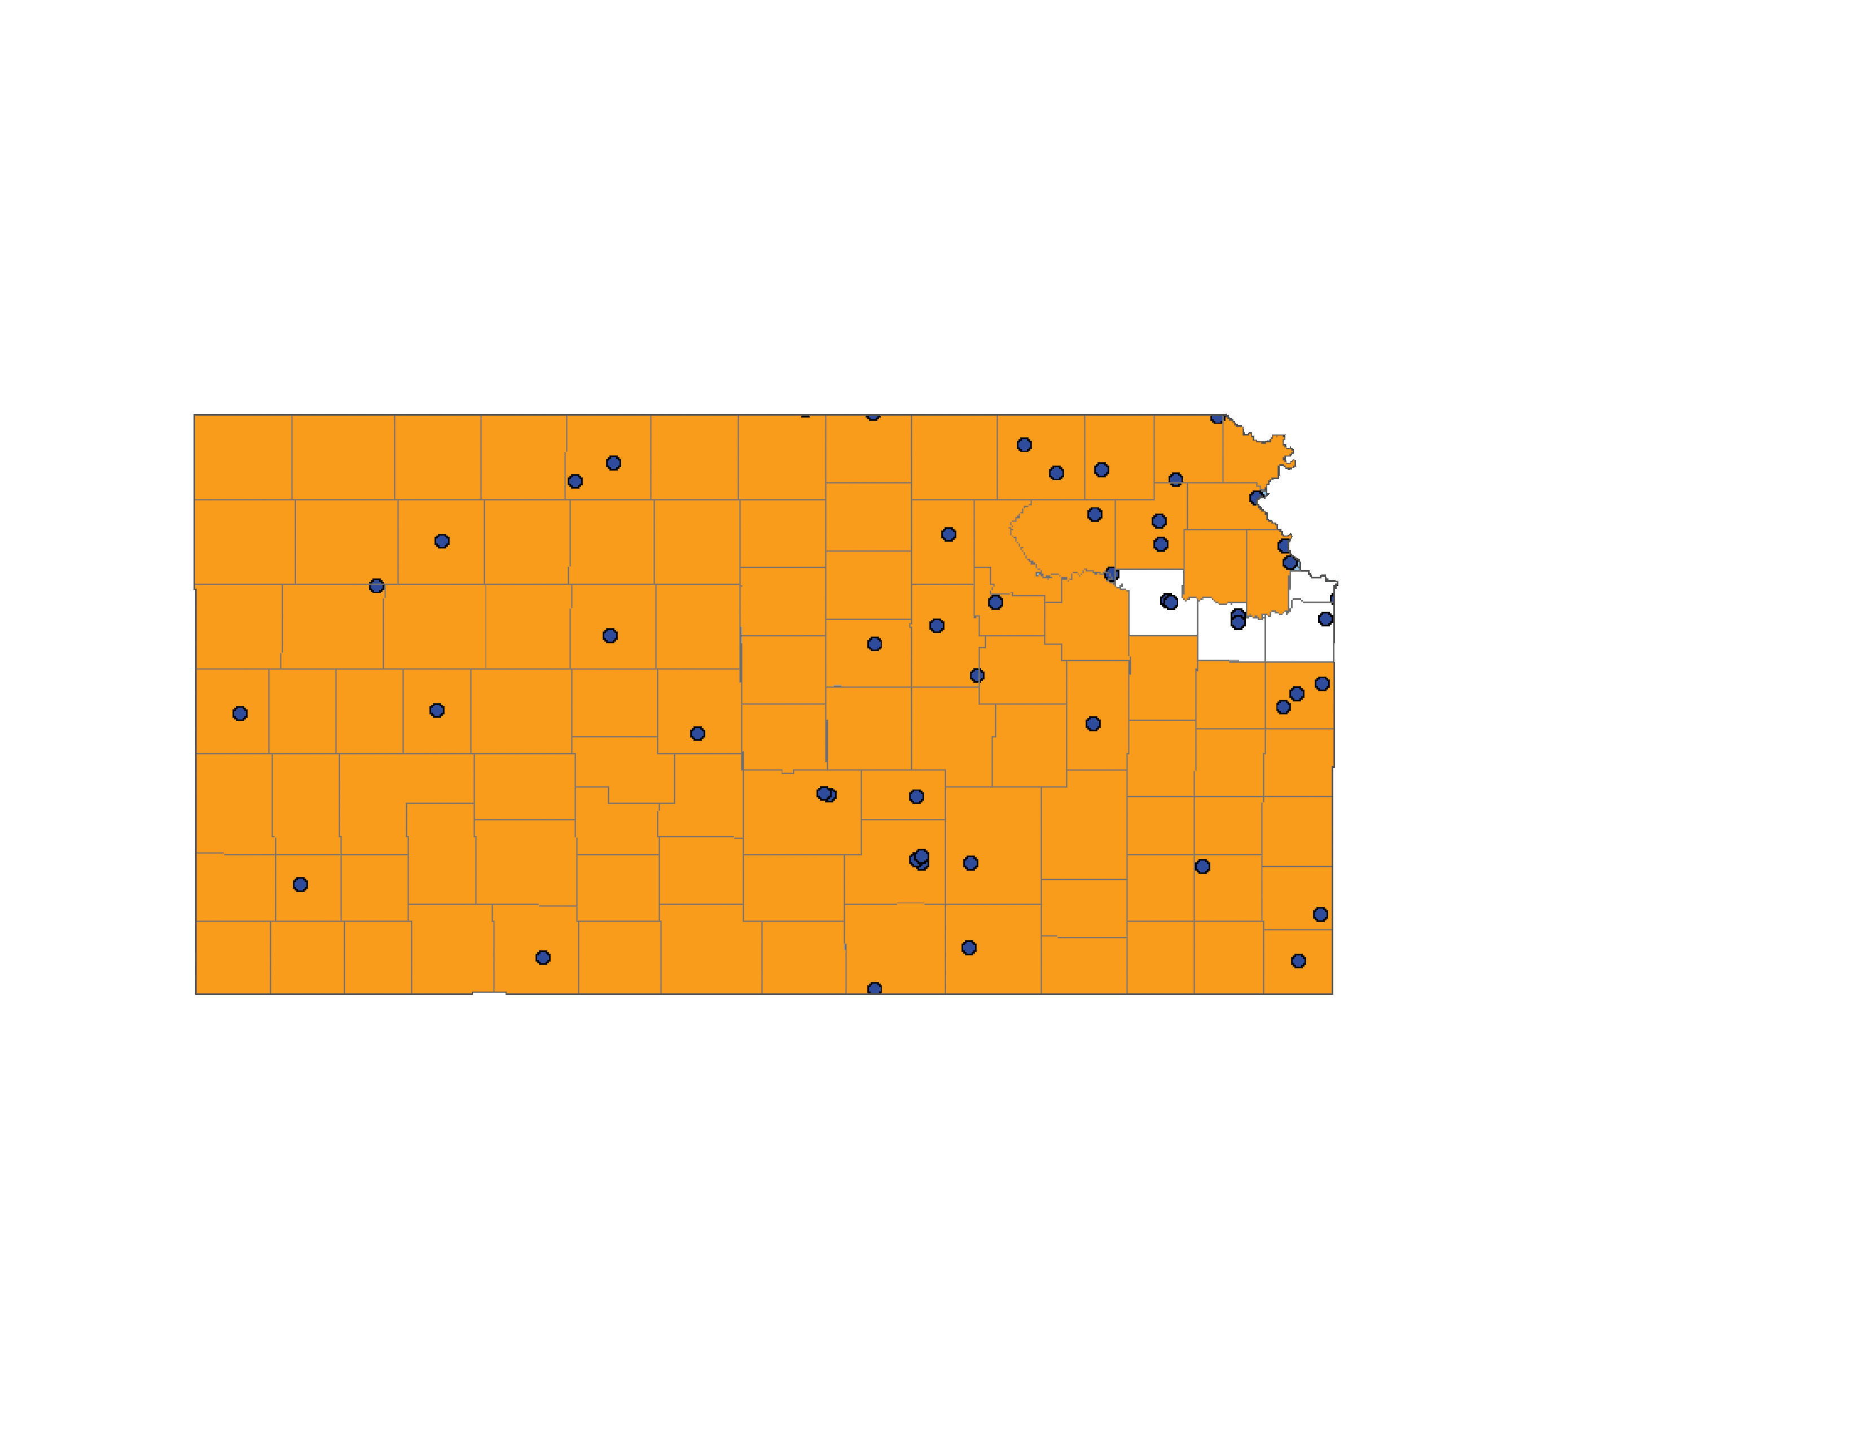
Shortage of behavioral health care professionals
KANSAS 2018
Currently, Kansas has 27 full-time equivalent behavioral health care professionals in designated shortage areas and facilities with behavioral health care professional shortages. In order to address the shortage issue, 36 more full-time professionals are needed in these areas, 4 of whom are needed in correctional facilities.
In correctional facilities
Current workforce
Shortage of behavioral health care professionals
Geographic high needs area (orange)
Source: Health Professional Shortage Areas (HPSA), HRSA Data Warehouse, 03/16/2018
Specific facility with shortage of behavioral health care professionals
(blue dots)
Behavioral health care professionals:
psychiatrists, clinical psychologists, clinical social workers, psychiatric nurse specialists, and marriage & family therapists
Facilities:
Federal & state correctional institutions, state & county mental hospitals, community mental health centers, and other public or nonprofit private facilities
Geographic high needs area based on population-to-provider ratio, poverty levels, elderly and youth ratio, alcohol and substance abuse prevalence, and travel time to nearest source of care outside area

Slide 24
Shortage of behavioral health care professionals in the Kansas region
KANSAS 2018
This map shows widespread shortages of behavioral health care professionals in Kansas and bordering states, especially in rural areas. The severity of the shortage is measured on a Health Professional Shortage Area scale from 0 to 25, with 0 indicating no shortage, and 18 and above a severe shortage.
Iowa
Nebraska
Colorado
Kansas
Missouri
Oklahoma
Arkansas
Source: Health Professional Shortage Areas (HPSA), HRSA Data Warehouse, 01/01/2018

Slide 25
State population in behavioral health care professional shortage areas
KANSAS AND UNITED STATES 2018
1,388,836 people in Kansas (48% of the state population) reside in designated shortage areas and/or are served by a facility with shortages of behavioral health care professionals. This is higher than the U.S. average of 30%.
Source: Health Professional Shortage Areas (HPSA), HRSA Data Warehouse, 03/16/2018, and Census Bureau data (2017)

Slide 26
MENTAL HEALTH CONDITIONS & THE CRIMINAL JUSTICE SYSTEM

Slide 27
Contact with criminal justice system
KANSAS 2016
People who experienced serious psychological distress (SPD) are more likely to have been arrested or be on parole or probation in the past year.
Source: National Survey on Drug Use and Health (NSDUH, R-DAS) 2015-2016
Survey does not include current institutionalized population

Slide 28
Mental health issues in prison and jail populations
UNITED STATES
A large percentage of the U.S. adult prison and jail inmate population currently experiences serious psychological distress compared to the non-institutionalized population.
Additionally, these mental health issues are observed at higher rates in local jails than in prisons.
Source: National Survey of Drug Use and Health (NSDUH) 2016
Bureau of Justice report: Sexual Victimization in Prisons and Jails Reported by Inmates, 2011-12,
based on data from the National Inmate Survey

Slide 29
State prison population with Serious Mental Illness
UNITED STATES
The increase in mental health care treatment in federal and state prisons after admission to prison suggests that these institutions are making up for the gaps in mental health treatment in the regular health care system.
At the same time, local jail inmates do not have the same access to medication and counseling while incarcerated as federal and state prisoners.
Counseling
Mental health conditions include prior diagnosis of depressive disorder, bipolar disorder, and/or schizophrenia. Medication and counseling data includes treatment for any mental illness.
Source: SISFCF (Survey of inmates in states and federal correctional facilities) 2004 &
SILJ (Survey of inmates in local jails) 2002
Draft – subject to change

Slide 30
Estimated number of
Kansas state prison inmates in 2016,
previously diagnosed with serious mental illness :
3,011
Estimate of overall annual costs in 2016:
$110,212,130
Overall annual costs based on 2016 average of all state prison inmates in Kansas
Source: Annual Survey of State Government Finances 2016
Survey of Inmates in State/Federal Correctional facilities, BJS, 2004
Kansas State, Department of Corrections Annual Report FY 2016

Slide 31
TOTAL ECONOMIC BURDEN OF SERIOUS MENTAL ILLNESS

Slide 32
Economic burden of serious mental illness
KANSAS 2016
The economic burden of schizophrenia, bipolar disorder, and major depressive disorder in adults in Kansas is estimated to be at least $300 million for each serious mental illness.
Source: MacEwan JP, Seabury S, et al. Pharmaceutical innovation in the treatment of schizophrenia and mental disorders compared with other diseases. Innov Clin Neurosci. 2016 Aug 1;13(7-8):17-25. See appendix for original sources
Due to symptom overlap, diagnoses of mental illnesses are not mutually exclusive, therefore, patients with two or more diagnoses may be represented in multiple categories.

Slide 33
Economic burden of serious mental illness
UNITED STATES 2016
The economic burden of schizophrenia, bipolar disorder, and major depressive disorder in adults in the U.S. is estimated to be at least $35 billion for each serious mental illness.
Due to symptom overlap, diagnoses of mental illnesses are not mutually exclusive, therefore, patients with two or more diagnoses may be represented in multiple categories.
Source: MacEwan JP, Seabury S, et al. Pharmaceutical innovation in the treatment of schizophrenia and mental disorders compared with other diseases. Innov Clin Neurosci. 2016 Aug 1;13(7-8):17-25. See appendix for original sources

Slide 34
Lost productivity is the largest contributor to economic burden of serious mental illness
UNITED STATES
Medical costs
Most of the total economic burden of serious mental illness is due to lost productivity (unemployment, lost compensation (incl. caregivers), or early mortality). Only 12 to 47% of the total burden is resulting from direct medical costs (including substance abuse treatment), and an even smaller percentage from law enforcement, incarceration, shelters, or research & training (other costs).
This highlights the large potential economic and societal benefits from improving treatment for serious mental illness even if it means spending more on care.
Lost productivity
Other costs
Source: MacEwan JP, Seabury S, et al. Pharmaceutical innovation in the treatment of schizophrenia and mental disorders compared with other diseases. Innov Clin Neurosci. 2016 Aug 1;13(7-8):17-25. See appendix for original sources

