Slide 1

Federal Policy Update
National Council for Behavioral Health

Slide 2

News From Washington
FY 2019 Appropriations bills advance.
Various executive and legislative actions repeal or undercut portions of the ACA.
CMS moves to permit work requirements, other restrictions on Medicaid benefits.
Congress considers opioid legislation.
Notes:
MORE NARRATIVE
I want to start with a snapshot of what’s happening in Washington at the moment.
It’s appropriations season, so funding for FY 2019 is the hot topic right now.
Some activity that has been more under-the-radar is legislative and regulatory efforts that happening been chipping away at coverage expansions and consumer protections of Affordable Care Act.
One way that the Administration has been doing this is through the use of waivers, with new ways to restrict participation in Medicaid such as work requirements
However there is some hope on the horizon to add some new resources for people with SUDs as Congress has been working on legislation to address the opioid crisis for last few months.

Slide 3
FY 2018 Appropriations
Massive omnibus spending bill passed in March
  +$10.1 billion for federal health spending
    SAMHSA, NIH, CDC receive increases
    $4 billion dedicated to addressing opioid crisis
  Key programs:
    CCBHCs (+$100 million)
    Primary and Behavioral Health Care Integration (PIPBHC) (level funding)
    Mental Health First Aid (+$5 million)
    Opioid State Opioid Response(SOR) grants (+$1 billion)
    SAPT Block Grant (level funding)
Notes:
Before I get into appropriations for FY 2019 I want to remind everyone of where we are in terms of health spending for this year.
After many struggles, Congress finally passed a budget for FY 2018 in March, providing increases to agencies most important to behavioral health, SAMHSA, NIH, CDC and dedicated more funds specifically to the opioid crisis, totaling $4 billion altogether. In terms of specific programs, we were very happy to see Congress allocate $100 M in grant funds that are intended as a stepping stone for helping new clinics become CCBHCs. I know we have some CCBHCs in the audience and we’ll be talking a lot more about that program and its future later on.
We saw continued support for the SAPT Block Grant, primary and behavioral health care integration and Mental Health First Aid and Congress created the $1 Billion Opioid State Response Fund.
One of the important things to remember about the March budget deal is that not only set funding levels for FY 2018, but it also lifted scheduled spending caps for this year FY 2019.

Slide 4
FY 19 Labor-HHS Bills
Agency/Program | FY 2019 House | FY 19 vs FY 18 | FY 2019 Senate | FY 19 vs FY 18
SAMHSA | $5.6 billion | +$448 million | $5.7 billion | +$558 million
Mental Health Block Grant | $722.5 million | Level funding | $747 million | +$25 million
SAPT Block Grant | $2.4 billion | +$500 million | $1.9 billion | Level funding
Primary/BH Integration (PBHCI) | $49.9 million | Level funding | $49.9 million | Level funding
Mental Health First Aid | $20 million | Level funding | $22 million | +$2 million
State Opioid Response Grants | $1 billion | Level funding | $1.5 billion | +$500 million
CCBHCs Expansion Grants | $0 | -$100 billion | $150 million | +$50 million
NIH | $38.3 billion | +$1.3 billion | $39 billion | +$2 billion
Notes:
Onto the funding picture for this year, this chart show you proposed funding levels for SAMHSA and NIH, and specific behavioral health programs such and the Mental Health and Substance Abuse, Prevention and Treatment block grants, the primary care and behavioral health care integration grants and associated TA center, Mental Health First Aid, the State Opioid Response Fund and CCBHCs Expansion grants. You can see what House appropriators have agreed to thus far in gold column and what Senate appropriators are proposing in blue.
As you can see, the overall the news is pretty good. Both chambers would invest more in SAMHSA and NIH and keep at least level funding if not an increased investment for key BH programs. Notably, the House would also have a 500 million increase for the SAPT block grant, but would eliminate the CCBHC expansion grant program. We working with House Appropriations Offices to ensure that funding is maintained, if not increased as it is in the Senate bill.
What happens next? The chambers will need to reconcile their different plans. You’ll notice that the Senate has higher topline spending numbers so changes are definitely coming. Both bills have passed out of their respective committee and need to be scheduled for floor votes. However, Congress is running out of time to pass these before the current fiscal year expires on Sept. 30.
If you’re familiar with the Congressional budget process, you know that it is not uncommon for them to miss deadlines. Expect at least one continuing resolution. However, this is all very much in flux however, we continue to hear different reports day-to-day about the timeline of floor votes, so stay tuned for more information as we receive it.
We’ve also started to look ahead to FY 2020, where will likely have more of an uphill battle protecting and securing funding increase. Sequestration or the scheduled spending caps I talked about earlier will come back into effect. If the caps are not lifted again by Congress, the appropriations committees will be working with significantly less funding. We also expect the President to continue to recommend cuts to Medicaid and other valuable BH programs as he has in past budget documents.

Slide 5
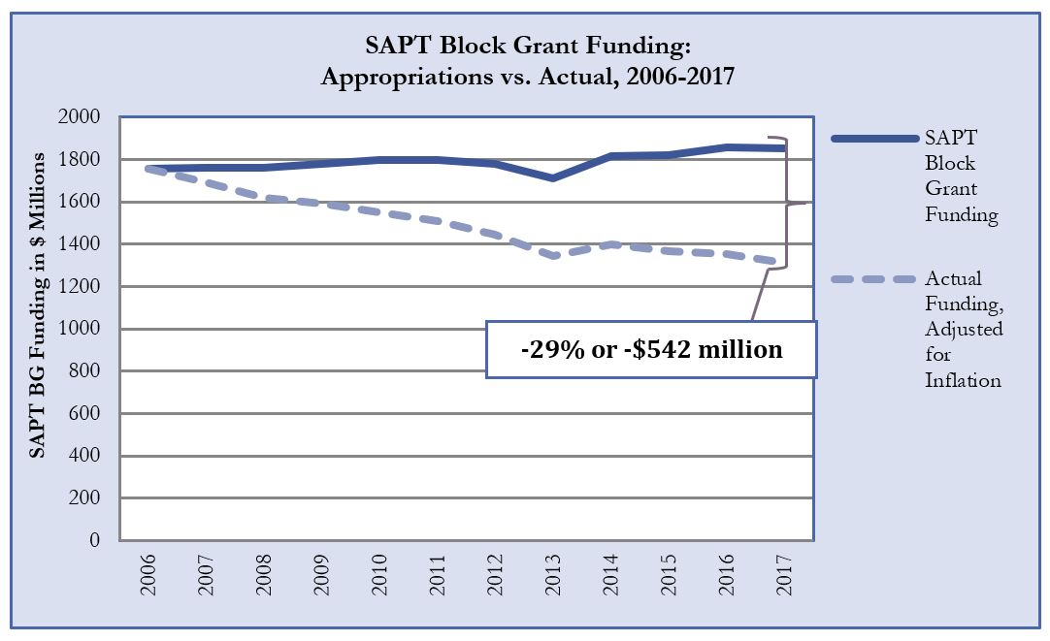
Notes:
Although we’ve seen some new money for treatment, we still don’t see much federal investment in prevention or recovery supports, which are critical resources for preventing SUDs and supporting long-term recovery.
SAPT-single largest source of prevention dollars and recovery support dollars, has lost a lot its purchasing power. Over the last 10 years, SAPT Block Grant funding has not kept up with health care inflation, resulting in a staggering 29% decrease in the real value of funding by FY 2017 (to $1.312 million).

Slide 6
State Opioid Response Grants
Purpose: To support evidence-based prevention, treatment and recovery support services for opioid use disorders (OUD).
Funding noncompetitive; distributed via a formula based on unmet need for OUD treatment and drug poisoning deaths in each state. 15% set-aside for 10 states hit hardest by opioid crisis.
Funds are to be used to supplement, not supplant, current state efforts to combat opioid abuse.
Notes:
MORE NARRATIVE
One pathway where states may be able to make up some of this ground is with the new SOR, the FOA came out in June, places a lot of emphasis on providing a comprehensive response to the opioid crisis, whereas other recent grants from SAMHSA have only focused on MAT.
The other important thing about these grants is that every state is guaranteed to receive an allocation, with no state receiving less than $4 million. And SAMHSA has made clear this funding is supposed to add to the state’s opioid activities, not simply fund any efforts that are already underway.

Slide 7
Addiction Treatment Quality
House Energy and Commerce Subcommittee on Oversight and Investigations looking at:
  Patient Brokering
  Certification for facilities, including recovery homes
SAMHSA changing how agency evaluates evidence-based programs
  National Registry of Evidence-Based Programs and Practices (NREPP) shut down
Notes:
The more recent federal investments in addiction services has drawn Congress’ attention to issues of quality and standardization across the addiction treatment industry.
The House Energy and Commerce Subcommittee on Oversight and Investigations Committee has held several hearings on
The message has really been that Congress wants to ensure that public funds are going to appropriate and legitimate facilities…
We’ve also seen this emphasis at SAMHSA, where the NREPP was recently shut down in part b/c the Asst. Secretary felt the evidence-base for some of interventions listed on the clearinghouse were not strong enough.

Slide 8

Tax Cuts and Jobs Act of 2017
Impact on insurance markets
Repealed the ACA’s individual mandate
  Little to no impact on premiums in CY 2018
  Substantial premium increases expected in future years as healthy enrollees drop coverage
    CBO estimates a 10% increase in premiums nationwide; Center for American Progress estimates a 16.40% increase nationwide (taking into account the individual mandate repeal and short term health plan expansion)
Did you know: The tax bill also doubled the standard deduction, shifting incentives away from charitable giving, resulting in an projected $13.1 billion loss in giving.
Notes:
The second large bucket we want to talk about is changes to the Affordable Care Act. After many failed attempts at the wholescale repeal of the ACA, Congress did manage to repeal the ACA mandate that all individuals have health insurance in larger tax reform law. This repeal will go into effect in 2019 and 13 million fewer people are expected to have insurance over the next ten years. The mandate was a key tool for bring healthy consumers into the marketplaces and keeping costs down, and thus it’s repeal is expected to result in substantial premium increases for consumers buying plans on the individual market in the coming years.
As an aside, you should know that the Tax Cuts and Jobs Act has a provision it that we fear could disrupt your ability to fundraise and reduce the amount of charitable dollars you receive, which can be a very important revenue stream for many National Council members. The bills doubled the standard tax deduction, so ppl who itemized in the past are expected to now just take the standard deduction. With less of an incentive to itemize, charitable giving in the US to decline by up to $13.1 billion. Start thinking through possible adjustments to your fundraising strategy knowing that tax incentive to give has been reduced.

Slide 9
Meanwhile, at the White House…
Action on EHBs, AHPs and STLD policies
New Essential Health Benefits Selection Process
  Less comprehensive health plans, including plans lacking strong MH/SUD coverage
Association Health Plans (AHPs)
Short Term Health Plans (STLD plans) Fact Sheet
Notes:
MORE NARRATIVE | LESS WORDY
Meanwhile, at the White House, the Trump Administration has finalized two rules: one to loosen the ACA’s EHB requirement and one to allow for greater use of association health plans.
The EHBs mandated that 10 benefit categories be covered in plans sold on the individual and small group markets; mental health and substance use disorder services are one of those categories. The new rule will dramatically change the way states can select their Essential Health Benefits by allowing states to choose plans (and benefit categories) from other states, or to create a new benefit plan from scratch. While the rule was pending, the National Council came out strongly against this new EHB selection process as it will likely lead to a race to the bottom across states, encouraging states to pursue less generous and more narrow benefit designs that will increasingly harm and discriminate against consumers facing mental illness and/or substance use disorders.
The Department of Labor’s (DOL) final rule would expand association health plans (AHPs), also known as Small Business Health Plans, to small employers, sole proprietors, self-employed individuals and their families. These groups can band together based on profession or geographic area to form a single group to purchase insurance. The association health plans are exempt from ACA consumer protections including the EHB, protections for people with pre-existing conditions and MH/SUD parity.
Overall with these moves we’re seeing a return to the kind of bare-bones health plans that were common pre-ACA. The National Council has spoken out against these efforts b/c they will not provide the coverage individuals with behavioral health conditions need and will increase out-of-pocket costs for consumers.
We fully expect a regulation on STHPs. With that rule, we fully believe will see the full erosion of covered benefits, denials for coverage, and a complete lack of coverage for acute events like suicide or injury resulting from alcohol or drug use. The National Council, Families USA and NAMI partnered to release a fact sheet highlighting these plans’ lack of coverage for critical mental health and SUD benefits.
Not only are a lot of changes on the private market, but to Medicaid as well.

Slide 10
Emphasis on “Flexibility”
“Today, we commit to ushering in a new era for the federal and state Medicaid partnership where states have more freedom to design programs that meet the spectrum of diverse needs of their Medicaid population…”
–Former Sec. Tom Price & Administrator Seema Verma
Notes:
The driving philosophy of Trump’s health team has been increasing state flexibility in designing and administering their Medicaid programs. Unfortunately, this flexibility has mostly been used to promote strategies to reduce Medicaid enrollment and rollback spending.

Slide 11
Likely Medicaid waiver proposals
Work requirements
  KY decision has put these waivers under scrutiny
Drug testing
Higher cost sharing
Use of HSAs
Special enrollment & lockout periods
Time limit on coverage
  CMS rejected KS lifetime limit on coverage
Notes:
These new restrictions we’re seeing are coming in the form of Medicaid waivers with work requirements are the big trend in waivers right now. Kentucky was the first state to receive approval for work requirements, however it’s waiver approval was overturned in court. We’ll dive into that decision in a moment.
Other waivers proposals cover…list rest of list

Slide 12
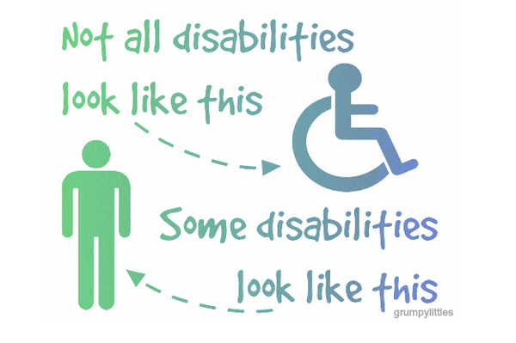
Exemptions?
“Disability” is often touted as a category of exemption from new waiver requirements.
Notes:
A lot of states are carving out exemption categories for additional requirements for “disabled and/or medically frail populations”, but it really not clear if individuals with mental illness and substance use disorders will be captured in those categories.
And even in the instances that they are, we have grave concerns that b/c possible cognitive impairment or other barriers, individuals many not be fill the paperwork required to claim an exemption.

Slide 13




Medicaid Work Requirements
CMS released guidelines for states to create work requirements
  Proposals approved in Kentucky, Indiana, Arkansas, New Hampshire; seven other states have applications under review
Notes:
Back in November, CMS offered states guidance on enacting Medicaid work requirements through 1115 waivers. Under prior administrations, waivers to require Medicaid enrollees to work a specific number of hours to maintain health coverage were never approved.
Four have enacted work requirements. Seven more are pending—however, we expect those decisions to be placed on hold for the moment while CMS evaluates the KY court decision.

Slide 14
Work Requirements Halted
  Key Takeaways on Court Decision:
  Did not overturn work requirements outright
  Sets two important precedents:
    States must evaluate waiver’s impact on coverage
    Medicaid provides equal treatment of all groups covered by its statute, including Medicaid expansion populations.
Notes:
LESS WORDY on slide
June 29th Judge James Boasberg overturns CMS’ approval of KY waiver saying the state did not address how coverage would be impacted or adequately respond to the overwhelming number of comments opposed.
-The decision did not overturn work requirements outright, which is bad news b/c that means the decision did not invalidate the other states that received approval. But it was not b/c he approved of work requirement, he was just able to overturn CMS’ decision on more narrow ground about the state’s process in creating the waiver.
-The good news for other states though is it sets a couple important legal precedents.
Next steps: CMS plans to revisit and possibly revise waiver

Slide 15

Opioid Legislation
Breakout potential for 2018: Opioid-related legislation
  House and Senate have been working on packages for months
  Timeline: In flux
Notes:
Election years usually do not see much legislative action, however, one area that has the potential to make it through a lame-duck Congress in opioid-related bills.
Since the spring, the House and Senate have been working on separate, wide-ranging opioid packages. The House has passed it’s passage, while the Senate is still working many measures through committee.
The original goal of both chambers was to have a package ready for the President’s signature by Labor Day, but that timeline is very likely to slip.
We’re really to happy to see the attention on opioid addiction, but we no that’s not the whole story. We know that like what you see in Oregon, deaths from other substance are also rising. So in our response to this epidemic, we need to more to ensure that funds are also supporting a wide-range of treatment options, not services and supports that are specific to opioid use disorders.

Slide 16
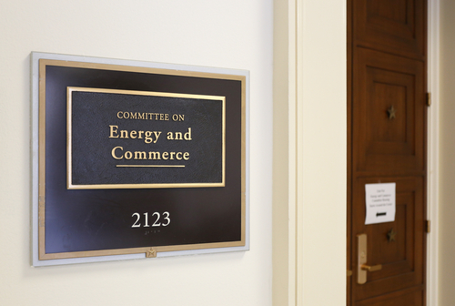
House Response
Substance Use-Disorder Prevention that Promotes Opioid Recovery and Treatment for Patients and Communities (SUPPORT) Act (H.R. 6) includes measures to:
  Expand Telehealth
  Disseminate Recovery Housing Best Practices
  Strengthen SUD Workforce
  Incentivize EHR use
  Preserve MAT prescribing expansions
  Extend Parity to CHIP
Notes:
Let’s Talk about what’s in these packages, the House has rolled up most of their bills into H.R. 6, which contains provisions to..
The Special Registration for Telemedicine Clarification Act (H.R. 5483): Requires the Drug Enforcement Agency (DEA) to establish a special registration process for certain providers that wish to prescribe controlled substances via telemedicine. This would remove barriers to accessing medication-assisted treatment for opioid use disorders in rural and frontier areas, and is a direct result of National Council advocacy efforts.
Ensuring Access to Quality Sober Living Act (H.R.4684): Requires the Substance Abuse and Mental Health Services Administration (SAMHSA) to identify and disseminate recovery housing best practices, such as the National Alliance for Recovery Residence’s (NARR) quality standards, to the states and provide them with technical assistance to adopt the standards. The bill aligns closely with the recommendations of the National Council’s State Policy Guide for Supporting Recovery Housing.
The Substance Use Disorder Workforce Loan Repayment Act (H.R. 5102): This bill would create a program to help addiction treatment professionals repay student loans, adding incentives for students to pursue these professions and ultimately increasing timely access to treatment for individuals living with addiction. This legislation was introduced as a result of education and advocacy by the National Council and the Association for Behavioral Health in Massachusetts.
Improving Access to Behavioral Health Information Technology Act (H.R. 3331): Incentivizes behavioral health providers to adopt electronic health records (EHRs). Behavioral health providers have adopted EHRs more slowly than physical health providers as they have traditionally not had the resources needed to implement the technology. A companion bill passed the Senate in May. Read Linda Rosenberg, President & CEO of the National Council’s endorsement of the bill here.
Makes permanent expansions in buprenorphine prescribing, including the ability for physicians to prescribe up for up to 275 patients and to allow for nurse practitioners and physicians assistants to prescribe.
The CHIP Mental Health Parity Act (H.R. 3192): Requires states to cover mental health and addiction treatment for pregnant women and children under the Children’s Health Insurance Program (CHIP). The measure ensures that the program covers behavioral health services at parity with physical health services and in a culturally and linguistically sensitive manner.
!!!!A number of these provisions came directly from the National Council and National Council members, and so we’re thrilled to see them included.!!!!

Slide 17
Other House Measures
IMD CARE Act: In-patient OUD treatment for individuals for up to 30 days
The Overdose Prevention and Patient Safety Act: Would align 42 CFR Part 2 with HIPAA
Notes:
While the opioid packages largest consistent of bipartisan, noncontroversial measures, two bills have generate debate.
The IMD CARE Act (H.R. 5797) lifts what is known as the “IMD exclusion,” to provide Medicaid payments for in-patient opioid addiction treatment for individuals for up to 30 days in certain facilities. The National Council has long supported lifting the IMD exclusion, but the bill’s exclusive focus on individuals with opioid addiction raises concerns about accessibility of services for individuals living with addiction to other substances. Moreover, a continued lack of investment in community-based care could hinder individuals’ progress toward recovery if they are unable to access timely, high-quality outpatient services upon leaving residential care. We’re also very concerned about seeing up a treatment structure that would service only one type of substance use disorder.
Overdose Prevention and Patient Safety Act (H.R. 6082) would align 42 CFR Part 2 with HIPAA.
So far these have not been included in the Senate package so its not clear if they will be addressed.

Slide 18
Senate Response
Senate Health, Education, Labor, & Pensions (HELP) Committee passed the Opioid Crisis Response Act (S. 2680) that would include many of same initiatives:
  Expand Telehealth
  Disseminate Recovery Housing Best Practices
  Strengthen SUD Workforce – NHSC bills
  Preserve MAT prescribing expansions
  Reauthorize the Opioid State Targeted Response Grant Program
  Spur development for new pain & addiction treatments
Notes:
Many of the same initiatives, with a slightly different approach to supporting the SUD workforce:
Promotes the Substance Use Disorder Treatment Workforce: By adding substance use disorder (SUD) providers to the list of providers eligible for loan repayment through the National Health Service Corps, the bill would increase access to care for individuals living with SUD.
Bill would also reauthorize Opioid STR fund which expires this year and provides funding for NIH to develop new pain and addiction treatments
A reminder about timeline -- Both chambers had hoped to have an opioid package to the President’s desk before they break for August recess, but that likely won’t happen. So we’re hoping to see them come back after August and after the election to finish their work.

Slide 19

Caveats
Few bills spend money
Not a comprehensive response
Investment via grants, not coverage
Notes:
Few bills spend money—we’re not going to address the many gaps in continuum of care without meaningful and long-term investment.
Opioid-specific response, where we no from the data the response should be broader to better address addiction as a whole
And grants are time-limited, not sustainable in the longer term and will only be received by certain communities.
At this point in the presentation, I’m want turn it over to Becca to talk about how we might achieve some of the more robust and sustainable solutions we want to see.

Slide 20
Potential Solution:
CCBHCs
Built on the concept that the way to expand care is to pay for it
National definition re: scope of services, timeliness of access, etc.
Standardized data and quality reporting
Payment rate that covers the real cost of opening access to new patients and new services…
  …including non-billable activities like outreach, care coordination, and more…

Slide 21
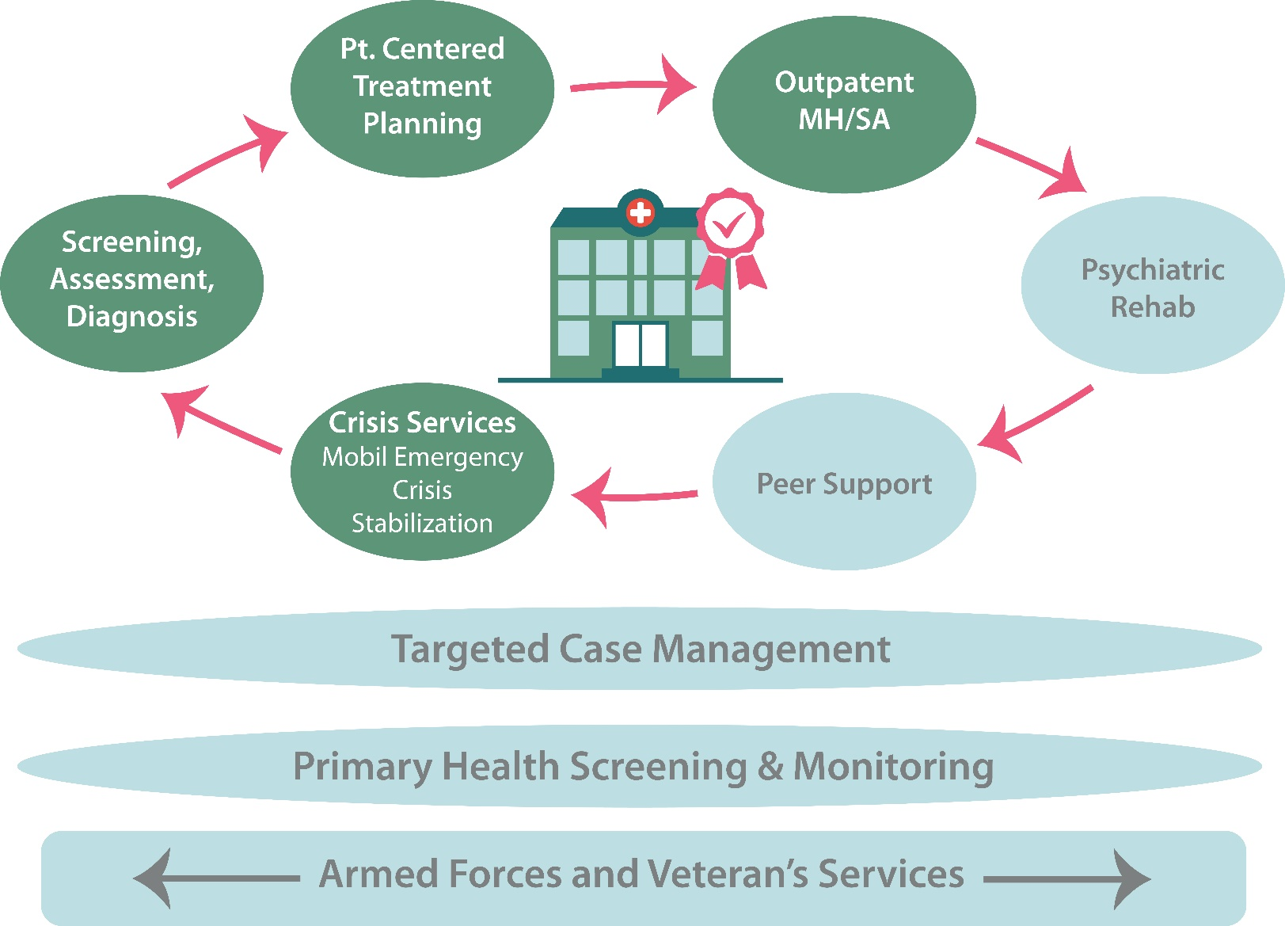
CCBHC Scope of Services
Must be delivered directly by CCBHC
Delivered by CCBHC or a Designated Collaborating Organization (DCO)

Slide 22
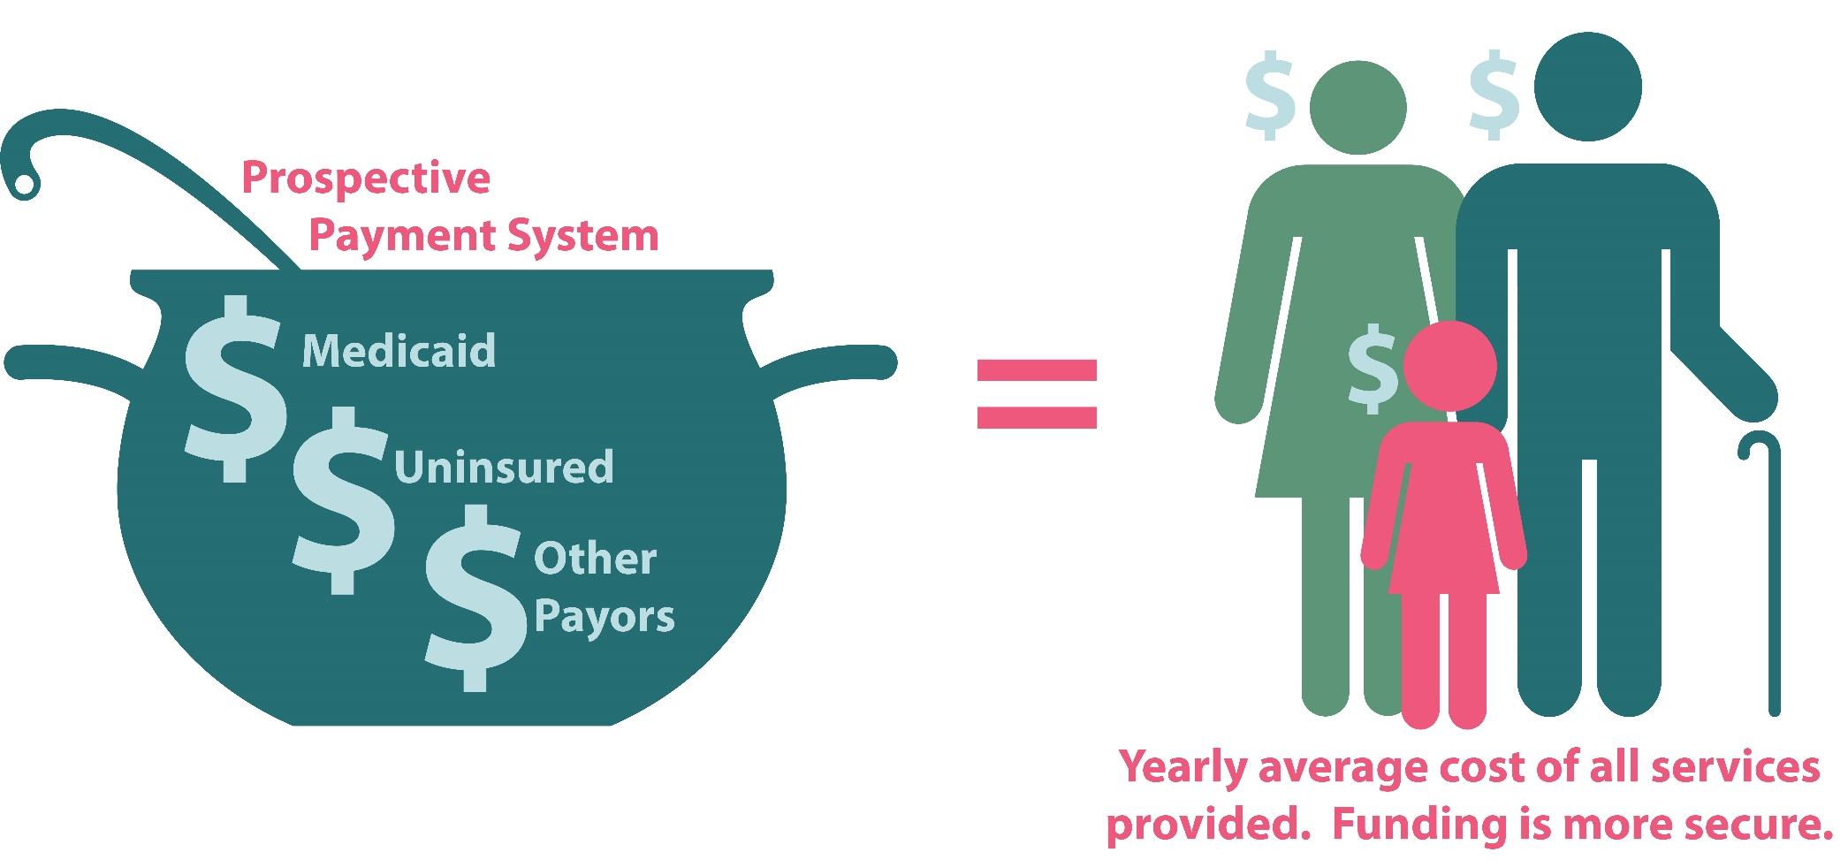
CCBHC Payment
Establishment of a Prospective Payment System

Slide 23
Evidence-based practices
Based on community needs assessment, states must establish a minimum set of required evidence based practices, such as:
  Motivational Interviewing
  Cognitive Behavioral individual, group, and on-line therapies (CBT)
  Dialectical Behavioral Therapy (DBT)
  First episode early intervention for psychosis
  Multi-systemic therapy
  Assertive Community Treatment (ACT)
  Forensic Assertive Community Treatment (F-ACT)
  Community wrap-around services for youth and children
  And more…
Notes:
This list is not exhaustive

Slide 24

In the first 6 months of implementation…
CCBHCs added 1160+
new positions to their staff… and mass hiring continues!
“CCBHC status has allowed us to court and hire more highly qualified candidates, because we can now offer more competitive salaries.”

Slide 25

Key staff expansions
Within the first 6 months, CCBHCs hired:
72 psychiatrists
64% hired peer recovery specialists
Within the first year:
398 new staff with an addiction specialty or focus
90% of CCBHCs have a psychiatrist on staff with an addiction specialty/focus

Slide 26

In the first 6 months of implementation:
87%
of CCBHCs report an increased number of patients served, representing up to a 25% increase in total patient caseloads for most clinics
Notes:
41/47 organizations

Slide 27
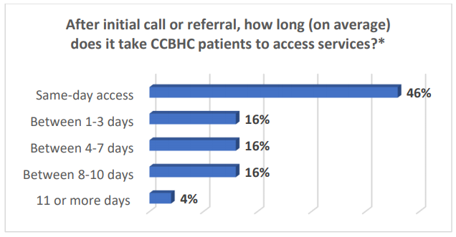
By end of Year 1:
68% of CCBHCs have decreased patient wait times
Notes:
An additional 30% have seen wait times hold steady despite increased in patient caseloads at most clinics

Slide 28
National evaluation study topics
Mathematica/RAND evaluation holds the keys to sustaining & expanding CCBHCs
Access to care: How has access increased?
Scope of services: Are CCBHCs able to fully implement the scope of services?
Quality: what is the quality of care provided to CCBHC clients?
Costs: Do the PPS rates cover the full cost of care for the CCBHCs?
Savings: What is CCBHCs’ impact on inpatient, emergency, and ambulatory service utilization rates as well as state and federal Medicaid costs?

Slide 29
CCBHC Expansion Grants
Funding and Awardees
Up to $2 million per grantee, per year for 2 years (Total = $4 million)
Up to 25 clinics will be selected
Total available funding ~$48 million
Grant terms begin Sept 30, 2018 and extend through Sept. 30, 2020 (6 months after end of CCBHC demo in Oregon)

Slide 30
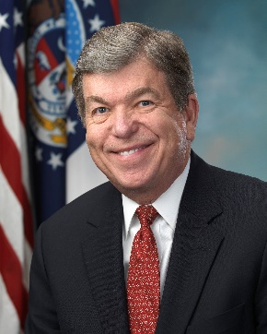
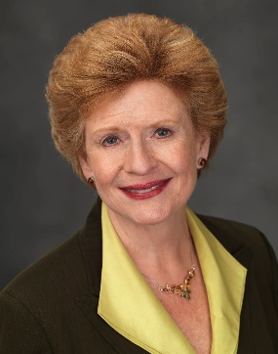
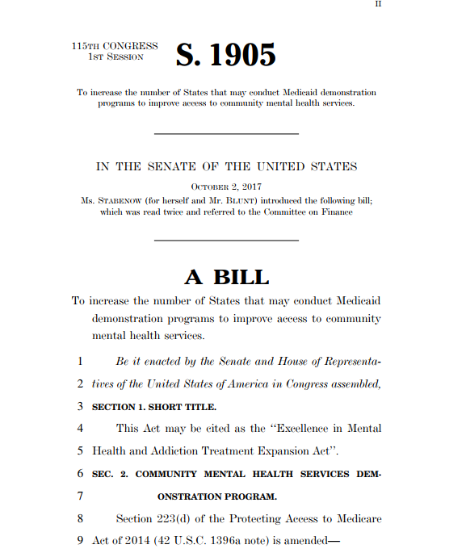
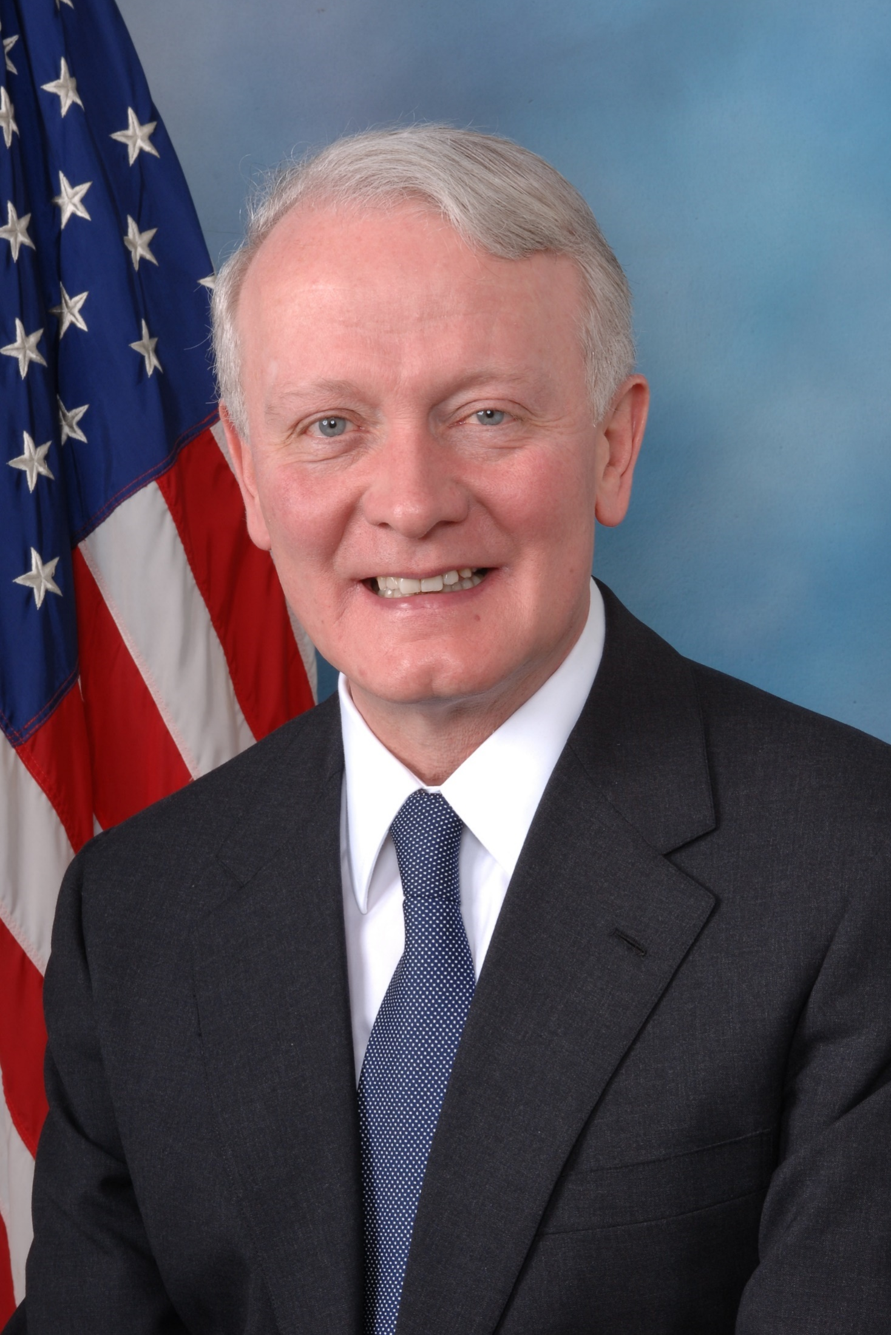
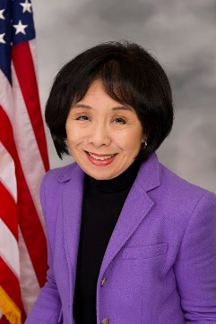
Excellence Act Expansion:
S. 1905/H.R. 3931
Sens. Roy Blunt and Debbie Stabenow
Reps. Leonard Lance and Doris Matsui

Slide 31
Shifting Focus from Volume to Value
Capitation
Value
Shared Savings
Episodic Bundles
Pay for Performance
Volume (FFS)
Incentives for health system investment in behavioral health care
Reduce ED overcrowding
Improve bed availability
Reduce inpatient length of stay
Prevent unnecessary readmissions
Improve clinical outcomes & reduce cost of care for complex, chronically ill populations
Notes:
In most of these payment models, there is very little downside risk
Understandable for the early years of an experiment, need to get lots of people to participate
This is slowly changing

Slide 32
Medicare Payment Rule
Proposed 2019 Medicare Physician Fee Schedule (MPFS) and Quality Payment Program (QPP)
  Key Provisions:
    Bundled payment for the care and management of substance use disorders (SUD)
    Expanded telehealth options
    Reduced billing documentation requirements

Slide 33

2018 Get Out the Vote (GOTV) Efforts
Voter Toolkit for 2018 Midterms
  How to Register Voters in your clinic
GOTV Webinar
  Wednesday, Aug. 15th at 2:30pm ET
Notes:
Join staff from the National Council’s Policy and Advocacy team to learn more about the do’s and don’ts for registering your clients to vote, and hear from Robert Davison, CEO of Mental Health Association of Essex and Morris, Inc. on best practices and lessons learned from his organization’s voter registration initiatives.

Slide 34

As former Senate Majority Leader Everett Dirksen (R-IL) said…
“When I feel the heat, I see the light.”

Slide 35

Questions?
Chuck Ingoglia
Senior Vice President,
Public Policy and Practice Improvement
Chucki@thenationalcouncil.org

