Slide 1
THE COST OF MENTAL ILLNESS:
KANSAS FACTS AND FIGURES
Michael Menchine MD MPH, Dana Goldman PHD, Seth Seabury PHD
Hanke Heun-Johnson PHD
Association of Community Mental Health Centers of Kansas – Annual Conference
September 12, 2018

Slide 2



Slide 3
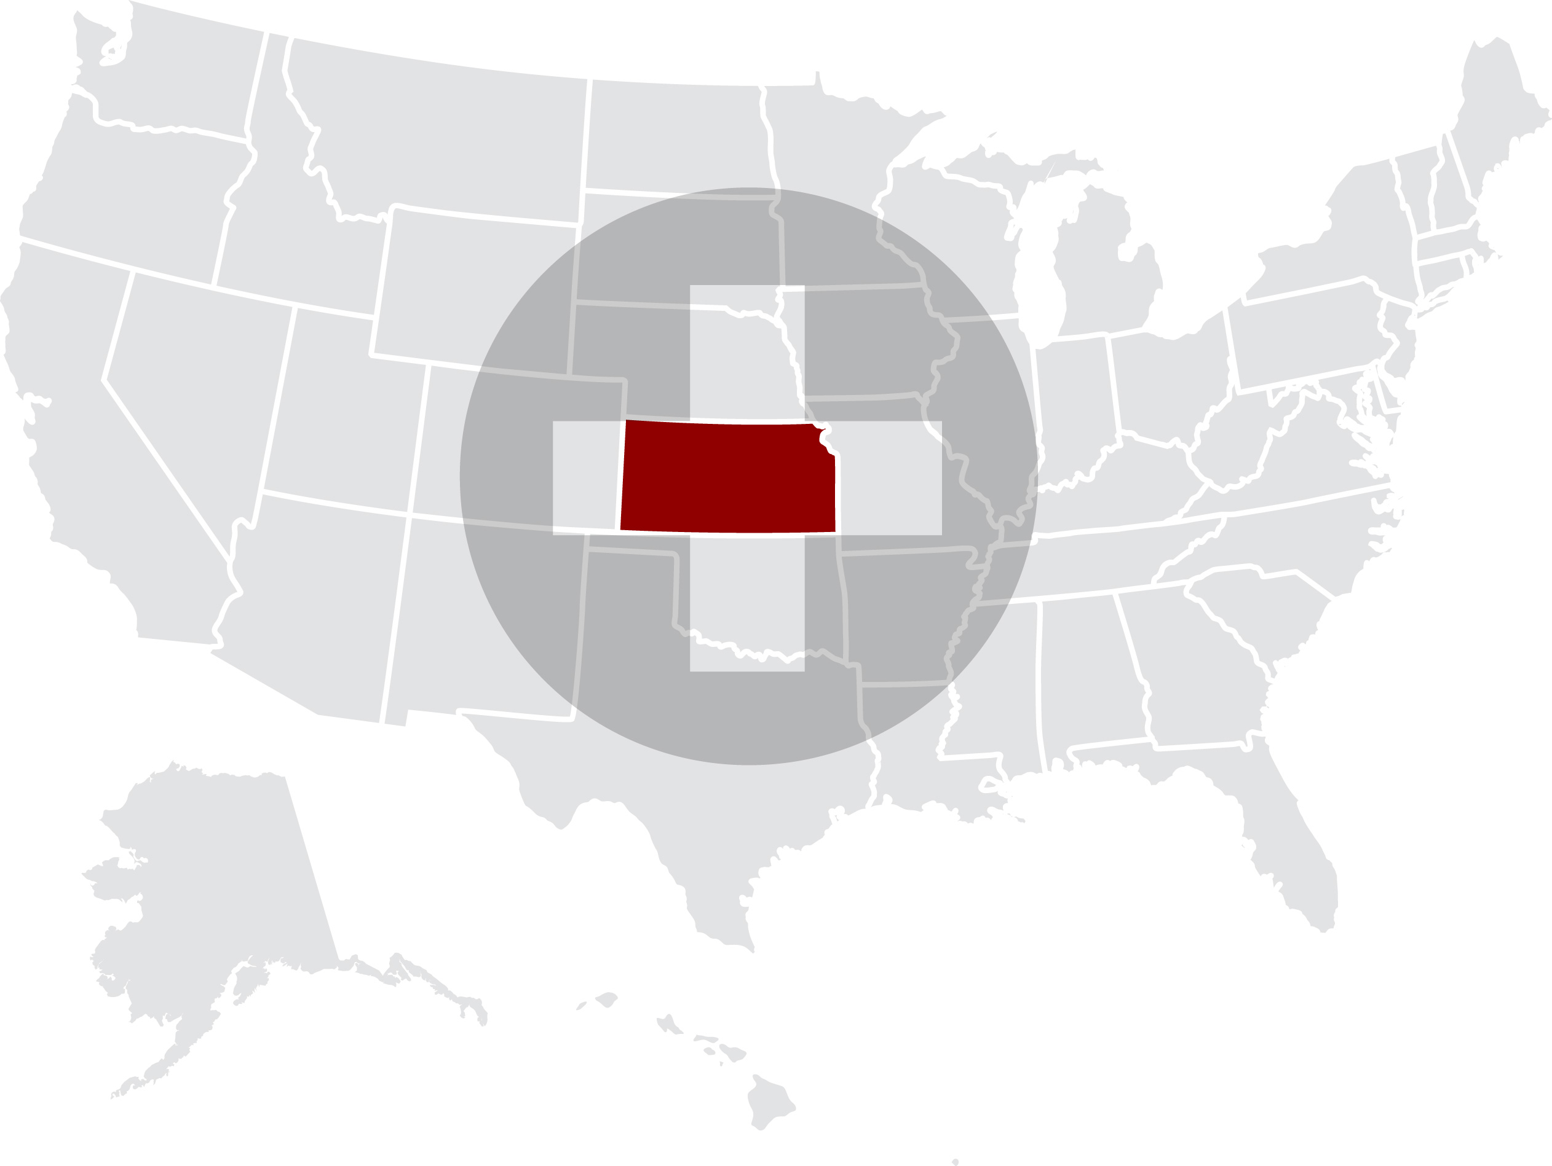
KANSAS
Notes:
Over the past couple decades , Increasingly we understand the genetic and environmental basis for many behavioral health conditions- which offers some reason for hope. When viewed as a product genetics and environment – particularly it is allowing the commnity to see these beahavioral problem as symtpoms of the illness rather than some moral terpitude. Slowly this will allow a change in perception from judgment to treatment – sadly we’ve got a long way to go here still.

Slide 4
INTRODUCTION
Improving access to high-quality medical and behavioral health care for patients with mental illness remains one of the most vexing problems facing the health care system in the United States.
In Kansas, there is concern that access to affordable mental health care has been hampered by the state’s fiscal issues and policy decisions.
This talk and accompanying chartbook offers an overview of the behavioral health system in United States and Kansas with respect to:
1) the population in need and with unmet needs 2) the workforce available to serve 3) funding difficulties faced 4) the interaction with the criminal justice system and 5) the economic impact associated with treatment of individuals suffering from mental illness.
Notes:
Individiuals with serious behavioral health conditions are often not working, ostracized from their family, intermittently incarcerated, lack motivation and/ or have have little insight into the value of treatment.
Traditionally these facts have been viewed as a collection of moral failures and because they have been seen as moral faiures, it has been relatively easier to view the people make the people suffering as less worthy of health care dollars or attention –
Increasingly we understand the biologic basis for many behavioral health conditions which offers some reason for hope. – particularly it is allowing to see these issues as symtpoms of the illness rather than some moral terpitude. Slowly this will allow a change in perception from judgment to treatment – sadly we’ve got a long way to go here still.

Slide 5
KEY OBJECTIVES
QUANTIFY THE POPULATION LIVING WITH MENTAL ILLNESS IN CONNECTICUT AND THE U.S.
REVIEW MENTAL HEALTH CARE COVERAGE, UTILIZATION & COSTS
Medicaid & mental health care needs
Unmet mental health care needs
Hospital utilization & charges
State mental health funding for community-based programs
DESCRIBE SUPPLY OF MENTAL HEALTH CARE PROVIDERS
EXAMINE INTERACTION BETWEEN MENTAL THE CRIMINAL
JUSTICE SYSTEM & PERSONS SUFFERING FROM MENTAL ILLNESS
SUMMARIZE TOTAL ECONOMIC BURDEN OF SERIOUS MENTAL ILLNESS

Slide 6
SKIPPING FORWARD
Key findings include:
Kansas has a fewer behavioral health care professionals per capita compared to the rest of the U.S., and shortages are particularly evident in rural areas- nearly ½ of Kansans live in a shortage area.
Though Kansas does better than the nation overall, hospitalizations rates for patients with serious mental illness are very high, which imposes a large cost on the health care system due to the relatively long length of stay, despite the general absence of procedures.
People living with mental illness in Kansas are more likely to encounter the criminal justice system than the rest of the US. The overall annual cost of incarcerating people with serious mental illness in state prisons in Kansas exceeds $110 million annually.
The data and methods are described in more detail @ http://healthpolicy.usc.edu/Keck_Schaeffer_Initiative.aspx

Slide 7
QUANTIFYING THE POPULATION LIVING WITH MENTAL ILLNESS IN KANSAS AND THE U.S.

Slide 8
KEY POPULATIONS OF INTEREST
SERIOUS PSYCHOLOGICAL DISTRESS (SPD)
When someone experiences serious psychological distress, he or she may have a diagnosed or undiagnosed mental health condition, such as major depressive disorder, bipolar disorder, or schizophrenia (described below). Serious psychological distress is determined by six questions on the Kessler-6 screening instrument, which measures the frequency of symptoms of depression, anxiety, and emotional distress during a specific time period
MAJOR DEPRESSIVE DISORDER
A mental illness that severely impairs a person’s ability to function, characterized by the presence of depressed mood, feelings of worthlessness, guilt, or helplessness, reduced concentration, ability to think, sleep problems, loss of interest or pleasure in activities, and/or recurrent thoughts of suicide
BIPOLAR DISORDER
A mental illness characterized by extreme shifts in mood and energy levels. During manic episodes, a patient has abnormally high energy and activity levels that lead to impairment in daily functioning or requires hospitalization to prevent harm to self or others. Delusions or hallucinations can also occur. Manic episodes may be alternated with major depressive episodes
SCHIZOPHRENIA
A debilitating mental illness that distorts a patient’s sense of reality. Symptoms of schizophrenia include hallucinations, delusions, confusion, cognitive and mood impairments, and extremely disorganized thinking
RISK FACTORS: GENETIC & EXTERNAL FACTORS
Many different genetic factors may increase risk, but no single genetic variation causes a mental illness by itself;
Specific interactions between the individual’s genes and environment are necessary for a mental illness to develop

Slide 9
Prevalence of mental illness
UNITED STATES 2016
Many mental health
conditions are fairly
common in the general
population.
Whereas any of these conditions can severely limit someone’s normal daily activities, three disorders are often labeled as
Serious Mental Illness:
major depressive disorder, bipolar disorder and
schizophrenia. These three disorders will be the focus of this chartbook.
NB: Due to symptom overlap, diagnoses of mental illnesses are not mutually exclusive
Source: National Survey on Drug Use and Health (NSDUH, R-DAS) 2015-2016 (SPD), NSDUH Mental Health Surveillance Study 2008-2012 (major depressive disorder) and National Institutes of Mental Health (other conditions – see appendix for original sources)

Slide 10
State variation in prevalence of serious psychological distress
KANSAS AND UNITED STATES 2016
The prevalence of serious psychological distress in the past year among adults in Kansas is 10.1%, which is slightly lower that the U.S. average of 10.5%.
Source: National Survey on Drug Use and Health (NSDUH, R-DAS) 2015-2016

Slide 11
Estimated number of people living with mental illness
KANSAS 2016
An estimated 220,000 adults in Kansas experienced serious psychological distress in the past 12 months.
Note that a patient can receive multiple diagnoses of a serious mental illness due to a high degree of overlap between the mental health conditions.
Source: National Institutes of Mental Health, National Institutes of Mental Health, National Survey on Drug Use and Health (NSDUH, R-DAS) 2015-2016, and NSDUH-MHSS 2008-2012. Estimate of # of people affected using total state population of 2,191,407 (18 years and over), Census Bureau data (2015)

Slide 12
Substance abuse in people with serious psychological distress
KANSAS 2016
People who experienced serious psychological distress in the past 12 months are more likely to abuse or be dependent on alcohol or illicit drugs during that same time period.
Source: National Institutes of Mental Health, National Institutes of Mental Health, National Survey on Drug Use and Health (NSDUH, R-DAS) 2015-2016

Slide 13
MENTAL HEALTH CARE COVERAGE, UTILIZATION
& COSTS
Unmet mental health care needs

Slide 14
There is significant unmet need for mental health care in Kansas
KANSAS 2016
Among adults who experienced
serious psychological distress
during the past year:
Among adults who experienced serious psychological distress in the previous year in Kansas, a fifth reported an unmet need for mental health care.
Half of the people with a perceived unmet need reported that they did not receive treatment because they could not afford it.
Unmet
need:
24.2%
Cannot
afford:
57.7%
24.2% indicates an unmet need of mental health treatment
Source: National Survey on Drug Use and Health (NSDUH, R-DAS) 2015-2016

Slide 15
Unmet need of mental health treatment
KANSAS AND UNITED STATES 2016
In Kansas, 24% of people with serious psychological distress have an unmet need of mental health treatment.
In Kansas’ general adult population, 4.1% of people reported an unmet need of mental health treatment.
Source: National Survey on Drug Use and Health (NSDUH, R-DAS) 2015-2016

Slide 16
Unmet need of mental health treatment due to costs differs by insurance coverage
UNITED STATES 2016
On a national level, the extent to which cost was a factor in driving unmet need for mental health care among those with serious psychological distress, varied by insurance status. People without health insurance were most affected by the inability to afford mental health treatment (75%), while those with VA/military health insurance coverage were least affected (13%).
Source: National Survey on Drug Use and Health (NSDUH) 2016

Slide 17
Unmet need of mental health treatment due to costs
KANSAS AND UNITED STATES 2016
In Kansas, 58% of people with serious psychological distress and an unmet need of mental health treatment, did not receive this treatment due to costs.
Source: National Survey on Drug Use and Health (NSDUH, R-DAS) 2015-2016
Notes:
And what about that 58% of people with an unmet need who reported it was due to lack of affordability – relative to the rest of the US this is very high = even relative to other nearby mid-western states it is very high (national average is 42%)

Slide 18
MENTAL HEALTH CARE COVERAGE, UTILIZATION
& COSTS
Medicaid & behavioral health care needs

Slide 19
People with mental illness have greater reliance on the safety net
KANSAS 2016
In the Medicaid and uninsured population, a higher percentage of adults in Kansas reported serious psychological distress (SPD) during the past year compared to people with Medicare, VA/military, or private health insurance coverage.
Percentage of adults with
serious psychological distress
by insurance type
Source: National Survey on Drug Use and Health (NSDUH, R-DAS) 2015-2016

Slide 20
Medicaid reimbursement rates to physicians are low
KANSAS AND UNITED STATES 2016
Low reimbursement rates are a disincentive for individual physicians to accept patients with Medicaid coverage and mental health problems. Compared to Medicare fee levels, Medicaid reimbursement rates are low in most states, including Kansas.
This can be a barrier for these patients to obtain access to mental health care.
Source, Kaiser Family Foundation, Medicaid-to-Medicare Fee Index, FY 2016
Notes:
A key problem with so much reliance on medicaid from the provider perspective is that it is not a great payer.
Acts as a disincentive for providers = which in trun no doubt contributes to the fact that many patients with mediciad insurance report an unmet need for mental health treatment
This is the general relationship between medicaid and medicare – not for specific mental health or substance abuse related items.

Slide 21
Medicaid reimbursement rates for behavioral health services by community providers are low
CONNECTICUT 2014
The 10 most utilized behavioral health services account for 75% of total service hours by community providers.
The service delivery cost for these procedures is higher than the revenue under Medicaid rates, resulting in negative margins and providers operating at a loss.
The annual loss for these procedures is more than $27 million for approximately 250,000 service hours.
Source: Prioritizing Community Based Services in CT, CT Community Providers Association, February 2015

Slide 22
MENTAL HEALTH CARE COVERAGE, UTILIZATION
& COSTS
Hospital utilization & costs

Slide 23
Hospitalizations for mental illness
KANSAS AND UNITED STATES 2014
In Kansas, the total number of hospitalizations is highest for adult patients with a principal diagnosis of major depressive disorder, whereas patients with schizophrenia disorder have a much higher rate of hospitalizations.
Compared to rest of the U.S., hospitalization rates in Kansas are slightly higher for patients with major depressive or bipolar disorder, but much lower for those with a diagnosis of schizophrenia.
3.4% of all hospitalizations in Kansas are due to SMI
Source: Healthcare Cost and Utilization Project (HCUPnet) 2014
Estimate of hospitalization rate: based on total state population (Census bureau data, 2014) and prevalence estimates reported previously

Slide 24
Length of stay for mental illness hospitalizations
KANSAS AND UNITED STATES 2014
The average hospital stay duration for adult patients with serious mental illness is relatively low in Kansas compared to the rest of the U.S., but remains higher than the average stay in a hospital for any diagnosis.
The total time spent in the hospital by adults with a primary diagnosis of serious mental illness is approximately 50,000 days each year in Kansas.
Source: Healthcare Cost and Utilization Project (HCUPnet) 2014

Slide 25
Hospitalizations of elderly patients with serious mental illness
KANSAS 2014
The length of stay in the hospital for serious mental illness in elderly patients is at least 60% higher on average than for younger adults with a similar diagnosis. Treatment of medical comorbidities due to aging, as well as difficulty finding long-term care environments may be at the root of this disparity.
Source: Healthcare Cost and Utilization Project (HCUPnet) 2014

Slide 26
Trends in length of stay for schizophrenia hospitalizations
KANSAS 2000-2014
The average stay for a schizophrenia hospitalization in Kansas was several days longer than for a hospitalization as a result of a heart attack or hip replacement.
Moreover, the latter have declined by at least 20% since 2000, while for schizophrenia the length of stay increased with 8%.
-20%
-42%
Source: Healthcare Cost and Utilization Project (HCUPnet) 2014

Slide 27
Average hospital costs for mental illness hospitalizations
KANSAS AND UNITED STATES 2014
Hospital costs in the U.S. and Kansas ranged from $4,600 to $7,000 per stay for patients with serious mental illness. This is despite a general absence of procedures or surgeries during a hospitalization for symptoms of serious mental illness.
Source: Healthcare Cost and Utilization Project (HCUPnet) 2014

Slide 28
Total hospital costs for mental illness hospitalizations
UNITED STATES 2014
The total costs for serious mental illness hospitalizations almost reached $7 billion in the U.S. in 2014.
Source: Healthcare Cost and Utilization Project (HCUPnet) 2014

Slide 29
Total hospital costs for mental illness hospitalizations
KANSAS 2014
Total hospital costs in Kansas for hospitalizations for serious mental illness together almost reached $50 million in 2014.
Source: Healthcare Cost and Utilization Project (HCUPnet) 2014

Slide 30
Total hospital costs for serious mental illness hospitalizations by insurance type
KANSAS 2014
Total hospital costs
(all ages, in 2016 U.S. $)
Compared to all hospitalizations, the expected payer for hospitalizations involving serious mental illness is much more likely to be Medicaid or the patients themselves, and less likely to be Medicare or private insurance.
Only a small fraction of the $3 billion in total hospitalization costs is covered by other programs (including VA/military health insurance), or paid by patients without health insurance.
Private insurance 26%
Private insurance 31%
Medicare 36%
Medicare 49%
Medicaid 18%
Other 12%
Medicaid 10%
Uninsured 9%
Uninsured 4%
Other 6%
Source: Healthcare Cost and Utilization Project (HCUPnet) 2014.
‘Other’ includes Worker's Compensation, TRICARE/CHAMPUS, CHAMPVA, Title V, and other government programs. ‘Uninsured’ includes ‘self-pay’ and ‘no charge’.
Hospitalizations for which the primary payer is ‘missing’ (0.1%) are excluded.

Slide 31
MENTAL HEALTH CARE COVERAGE, UTILIZATION
& COSTS
Investment in community-based programs

Slide 32
State Mental Health Agency spending
KANSAS AND UNITED STATES 2013
Kansas’ state mental health agency spending on mental health services per capita is very similar compared to the U.S. average ($129).
Expenditures include (on average):
72% Community-based mental health programs funded and/or operated by state mental health agencies
26% Mental health services in state psychiatric hospitals
2% Administration/training/ research/evaluation to support these services
$128
Source: State Mental Health Agency-Controlled Expenditures for Mental Health Services, FY 2013 National Association of State Mental Health program Directors Research Institute, Inc (NRI)

Slide 33
AVAILABILITY OF BEHAVIORAL HEALTH CARE PROFESSIONALS
This is an area where Kansas is further behind
Notes:
This is an

Slide 34
Availability of behavioral health care professionals
KANSAS AND UNITED STATES 2017
There are approximately 17 behavioral health care professionals for every 10,000 residents in Kansas, which is slightly lower than the average in the U.S. of 20 professionals per 10,000 residents.
Note that the U.S. average does not represent the optimal number of behavioral health care professionals.
Behavioral health care professionals include: psychiatrists, psychologists, licensed clinical social workers, counselors, marriage and family therapists, and advanced practice nurses specializing in behavioral health care
Source: County Health Rankings & Roadmaps, by the Robert Wood Johnson Foundation and the University of Wisconsin Population Health Institute.

Slide 35
Availability of behavioral health care professionals and hospital beds
KANSAS AND UNITED STATES 2013
Per resident, Kansas has slightly fewer psychiatrists, but more psychologists, compared to the U.S. average. The number of primary care physicians and hospital beds dedicated to psychiatric care are very similar in comparison to the average in the U.S.
Note that the U.S. average does not represent the optimal number of behavioral health care professionals or hospital beds.
Although the optimal number of beds is unknown in our current health care infrastructure, there are estimates that 5 beds per 10,000 residents are minimally required assuming sufficient availability of outpatient programs for long-term treatment.
Source: Area Health Resource Files 2013 (psychiatrists, physicians and psychiatric care beds), and 2005-2013 Demographics of the U.S. Psychology Workforce, American Psychological Association (psychologists)
Treatment Advocacy Center, “The Shortage of Public Hospital Beds for Mentally Ill Persons”

Slide 36
Shortage of behavioral health care professionals in the Kansas region
KANSAS 2018
This map shows widespread shortages of behavioral health care professionals in Kansas and bordering states, especially in rural areas. The severity of the shortage is measured on a Health Professional Shortage Area scale from 0 to 25, with 0 indicating no shortage, and 18 and above a severe shortage.
Iowa
Nebraska
Colorado
Kansas
Missouri
Oklahoma
Arkansas
Source: Health Professional Shortage Areas (HPSA), HRSA Data Warehouse, 01/01/2018

Slide 37
State population in behavioral health care professional shortage areas
KANSAS AND UNITED STATES 2018
1,388,836 people in Kansas (48% of the state population) reside in designated shortage areas and/or are served by a facility with shortages of behavioral health care professionals. This is higher than the U.S. average of 30%.
Source: Health Professional Shortage Areas (HPSA), HRSA Data Warehouse, 03/16/2018, and Census Bureau data (2017)

Slide 38
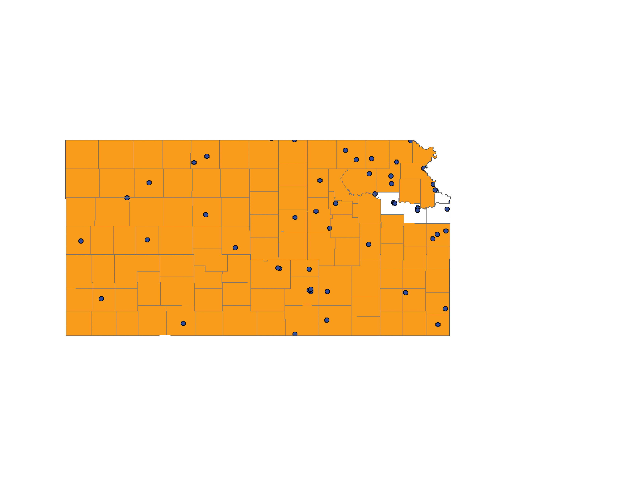
Shortage of behavioral health care professionals
KANSAS 2018
Currently, Kansas has 27 full-time equivalent behavioral health care professionals in designated shortage areas and facilities with behavioral health care professional shortages. In order to address the shortage issue, 36 more full-time professionals are needed in these areas, 4 of whom are needed in correctional facilities.
In correctional facilities
Current workforce
Shortage of behavioral health care professionals
Geographic high needs area (orange)
Source: Health Professional Shortage Areas (HPSA), HRSA Data Warehouse, 03/16/2018
Specific facility with shortage of behavioral health care professionals
(blue dots)
Behavioral health care professionals:
psychiatrists, clinical psychologists, clinical social workers, psychiatric nurse specialists, and marriage & family therapists
Facilities:
Federal & state correctional institutions, state & county mental hospitals, community mental health centers, and other public or nonprofit private facilities
Geographic high needs area based on population-to-provider ratio, poverty levels, elderly and youth ratio, alcohol and substance abuse prevalence, and travel time to nearest source of care outside area
Notes:
Dotted throughout the state are specific faciltities with healthcare professional shortages

Slide 39
MENTAL HEALTH CONDITIONS & THE CRIMINAL JUSTICE SYSTEM

Slide 40
Contact with criminal justice system
UNITED STATES 2016
People who experienced serious psychological distress (SPD) are more likely to have been arrested or be on parole or probation in the past year.
# of times arrested & booked
Source: National Survey of Drug Use and Health (NSDUH) 2016
Survey does not include current institutionalized population

Slide 41
Contact with criminal justice system
KANSAS 2016
People who experienced serious psychological distress (SPD) are more likely to have been arrested or be on parole or probation in the past year.
Source: National Survey on Drug Use and Health (NSDUH, R-DAS) 2015-2016
Survey does not include current institutionalized population
Notes:
This is Kansas specifically and we see that is is geenrally worse than the national avergees – that people with SPD are arrested and processed through the cirminal justice system at a higher rate than the US overall
In kansas, 1 in 20 people with SPD are arrested annually ; 1 in 18 are on parole

Slide 42
Mental health issues in prison and jail populations
UNITED STATES
A large percentage of the U.S. adult prison and jail inmate population currently experiences serious psychological distress compared to the non-institutionalized population.
Additionally, these mental health issues are observed at higher rates in local jails than in prisons.
Source: National Survey of Drug Use and Health (NSDUH) 2016
Bureau of Justice report: Sexual Victimization in Prisons and Jails Reported by Inmates, 2011-12,
based on data from the National Inmate Survey

Slide 43
State prison population with serious mental illness
KANSAS
Kansas state prison inmates
previously diagnosed with
a serious mental illness:
In Kansas state prisons, approximately 31% of prison inmates previously have been diagnosed with a serious mental illness, which is much higher than the overall U.S. prison population. Many patients have been diagnosed with two or three mental illnesses, confirming the presence of overlap in symptoms in this population.
Schizophrenia
or other psychotic disorder
8.0%
3.6%
Depressive
disorder
26.9%
2.8%
15.9%
1.6%
6.6%
0.9%
Bipolar disorder,
manic depression,
or mania
9.1%
Source: Survey of Inmates in State Correctional facilities, BJS, 2004. Includes juveniles
Due to rounding, percentages of separate parts may not add up to the total percentage
Notes:
In terms of SMI, this is prison, not jail (jail , we think has even higher rates – because a lot of people with SMI are arrested on trespass, loitering, bench warrants etc… and bever make it to prison

Slide 44
Change in treatment before and during incarceration in prison and jails
UNITED STATES
The increase in mental health care treatment in federal and state prisons after admission to prison suggests that these institutions are making up for the gaps in mental health treatment in the general health care system.
At the same time, local jail inmates do not have the same access to medication and counseling while incarcerated as federal and state prisoners.
Counseling
Mental health conditions include prior diagnosis of depressive disorder, bipolar disorder, and/or schizophrenia. Medication and counseling data includes treatment for any mental illness.
Source: SISFCF (Survey of inmates in states and federal correctional facilities) 2004 &
SILJ (Survey of inmates in local jails) 2002

Slide 45
Estimated number of
Kansas state prison inmates in 2016,
previously diagnosed with serious mental illness :
3,011
Estimate of overall annual costs in 2016:
$110,212,130
Overall annual costs based on 2016 average of all state prison inmates in Kansas
Source: Annual Survey of State Government Finances 2016
Survey of Inmates in State/Federal Correctional facilities, BJS, 2004
Kansas State, Department of Corrections Annual Report FY 2016

Slide 46
TOTAL ECONOMIC BURDEN OF SERIOUS MENTAL ILLNESS

Slide 47
Economic burden of serious mental illness
UNITED STATES 2016
The economic burden of schizophrenia, bipolar disorder, and major depressive disorder in adults in the U.S. is estimated to be at least $35 billion for each serious mental illness and about $400 billion total
$214,745,157,719
$146,206,423,054
$35,438,281,577
Due to symptom overlap, diagnoses of mental illnesses are not mutually exclusive, therefore, patients with two or more diagnoses may be represented in multiple categories.
Source: MacEwan JP, Seabury S, et al. Pharmaceutical innovation in the treatment of schizophrenia and mental disorders compared with other diseases. Innov Clin Neurosci. 2016 Aug 1;13(7-8):17-25. See appendix for original sources

Slide 48
Economic burden of serious mental illness
KANSAS 2016
The economic burden of schizophrenia, bipolar disorder, and major depressive disorder in adults in Kansas is estimated to be $3 Billion for serious mental illness.
$1,887,051,809
$1,284,768,884
Source: MacEwan JP, Seabury S, et al. Pharmaceutical innovation in the treatment of schizophrenia and mental disorders compared with other diseases. Innov Clin Neurosci. 2016 Aug 1;13(7-8):17-25. See appendix for original sources
Due to symptom overlap, diagnoses of mental illnesses are not mutually exclusive, therefore, patients with two or more diagnoses may be represented in multiple categories.
$311,405,655

Slide 49
Lost productivity is the largest contributor to economic burden of serious mental illness
UNITED STATES
Medical costs
Most of the total economic burden of serious mental illness is due to lost productivity (unemployment, lost compensation (incl. caregivers), or early mortality). Only 12 to 47% of the total burden is resulting from direct medical costs (including substance abuse treatment), and an even smaller percentage from law enforcement, incarceration, shelters, or research & training (other costs).
This highlights the large potential economic and societal benefits from improving treatment for serious mental illness even if it means spending more on care.
Lost productivity
Other costs
Source: MacEwan JP, Seabury S, et al. Pharmaceutical innovation in the treatment of schizophrenia and mental disorders compared with other diseases. Innov Clin Neurosci. 2016 Aug 1;13(7-8):17-25. See appendix for original sources

Slide 50
IN SUM
Nationally serious psychological distress affects 10.8% of adults annually
Major Depression affects 6%, Bipolar Disorder 2.6% and Schizophrenia 0.3%
Medicaid is a major financier of mental health services
Medicaid does not render behavioral health services completely affordable
Most outpatient behavioral health services for Medicaid patients lose money
Extended hospitalizations are common for patients with Serious Mental Illness
In Kansas, there is a general shortage of providers such that about 50% of the population lives in a shortage area
People living with mental illness are much more to be arrested and placed in correctional facilities where shortages of behavioral health professionals are severe
Those arrested are unlikely to have been receiving treatment
Annual total economic cost for Major Depression, Bipolar Disorder and Schizophrenia is $3 Billion in Connecticut – mostly from lost productivity
The data and methods are described in more detail in the appendix: http://healthpolicy.usc.edu/Keck_Schaeffer_Initiative.aspx
¹ http://ctmirror.org/2016/11/07/theres-a-lot-of-anxiety-mental-health-system-braces-for-more-cuts/

Slide 51
?

